Slide 1
Oscov’s Victorian orchids of the year 2018

Slide 2
Mem. Chris Waterman AUSTRALIAN NATIVE
HYBRID ORCHID
Sponsored by
Mornington Peninsula Orchid Society

Slide 3
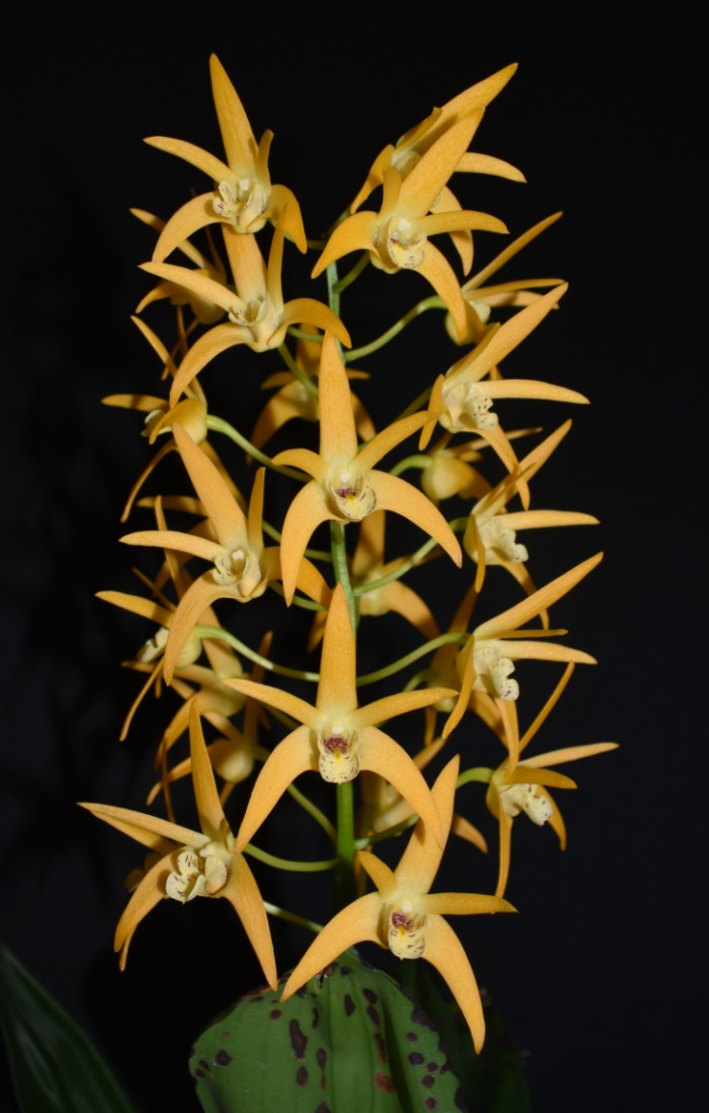
Den. Australian Gold Rush ‘Pure Gold’
The Hanging Garden
HCC/OSCOV
77.6

Slide 4
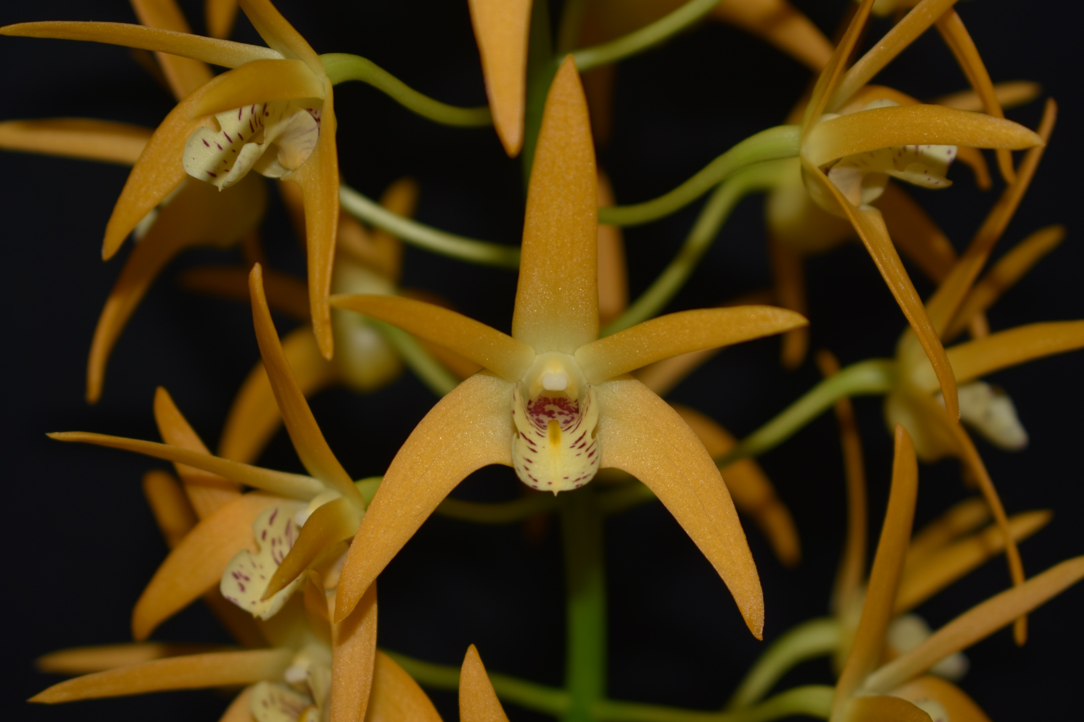

Slide 5
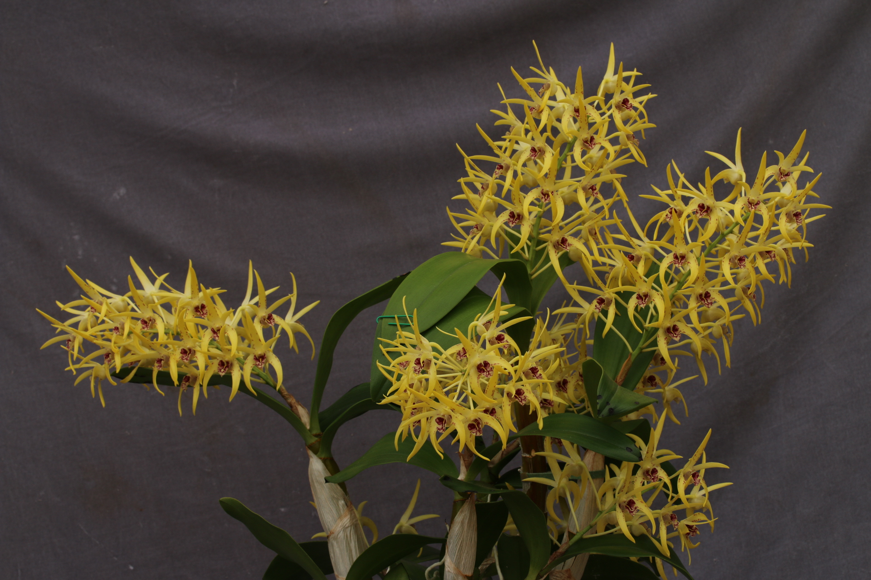
Den. Essie Banks ‘RACB’
Robin Bavinton
HCC/OSCOV
79.2

Slide 6
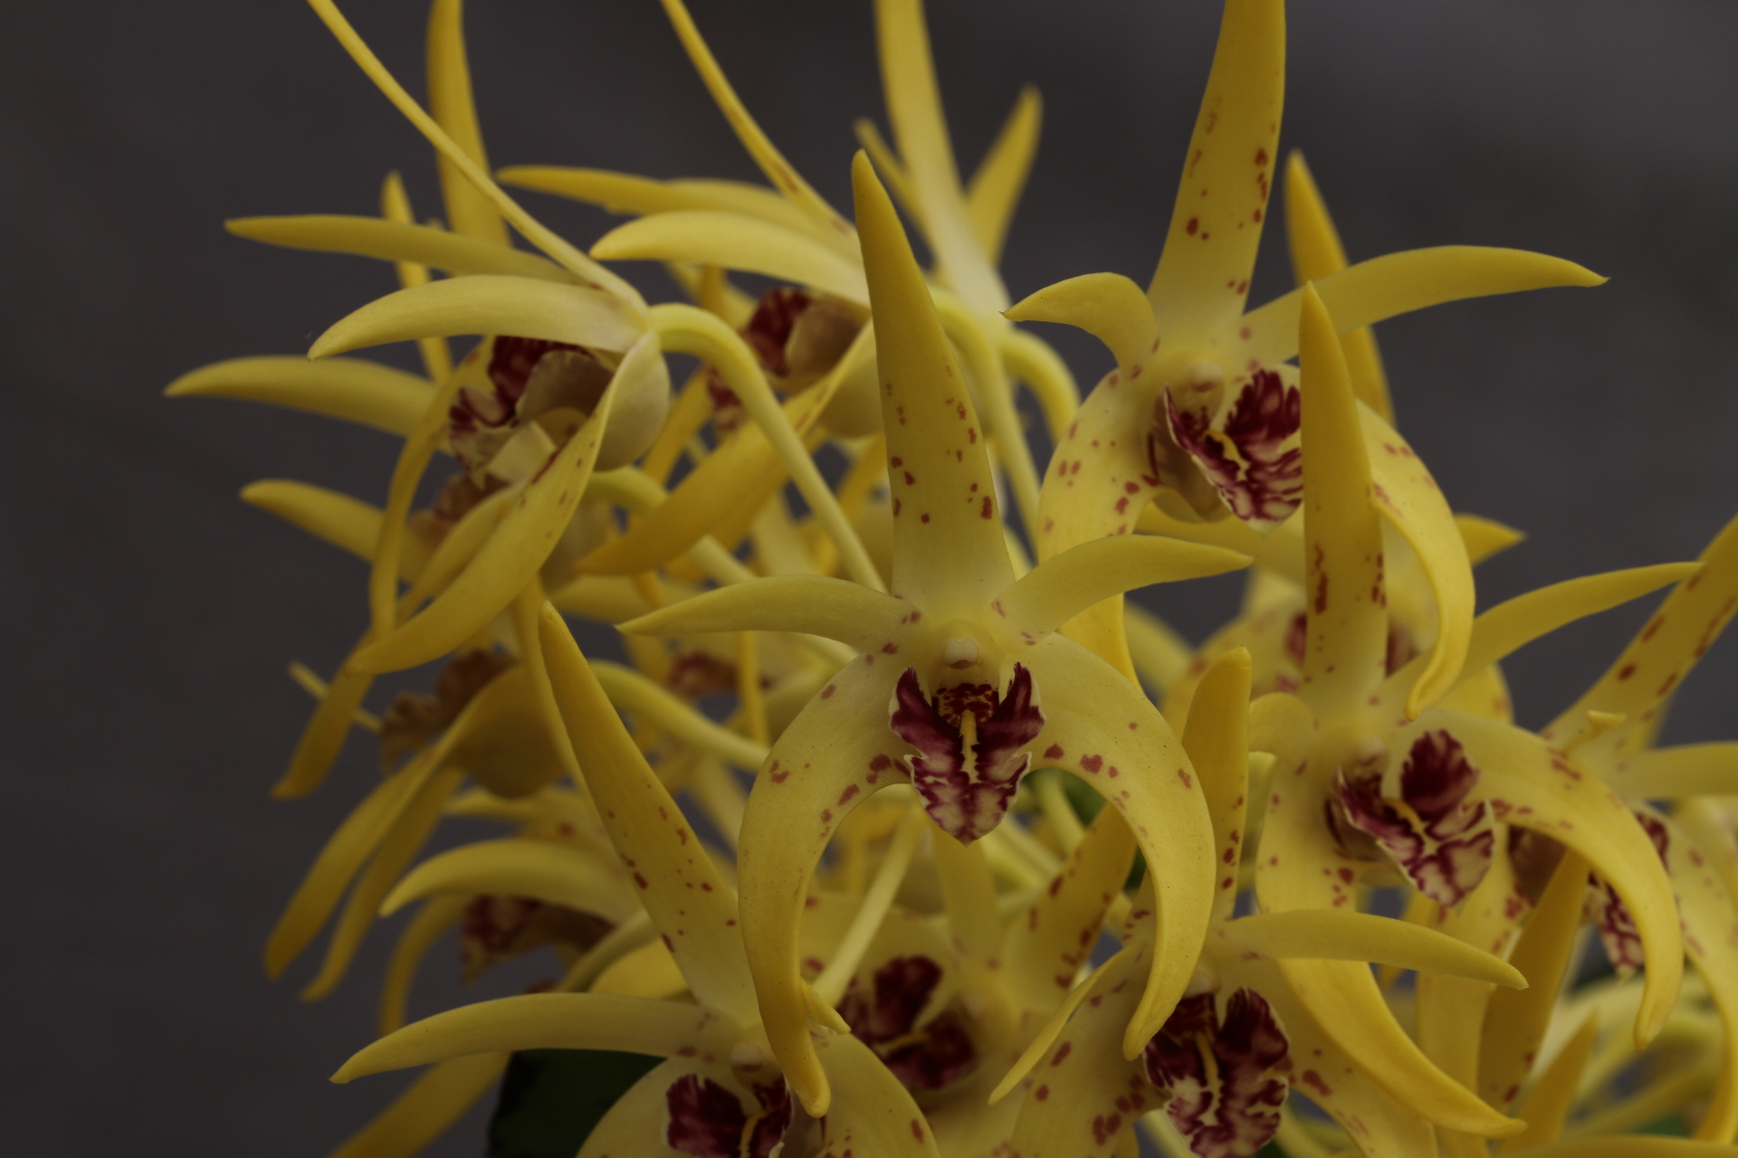

Slide 7
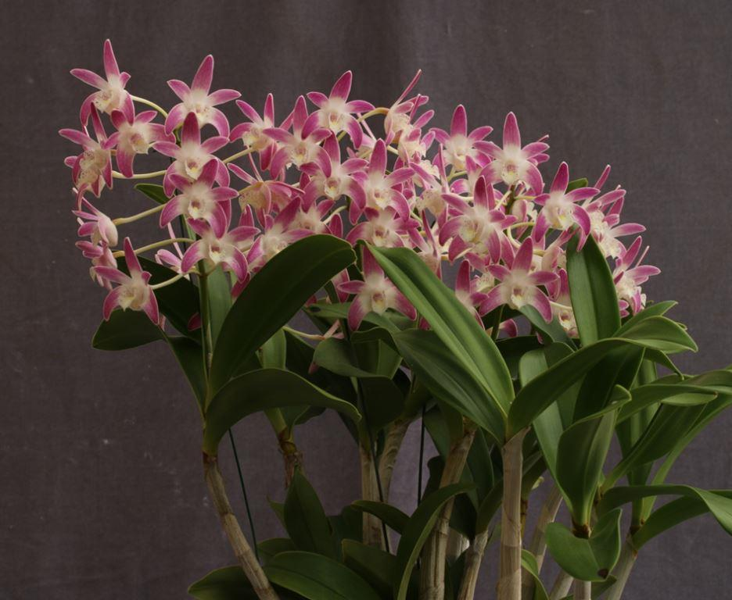
Den. Bav’s Beauty ‘RACB’
Robin Bavinton
HCC/OSCOV
79.9

Slide 8
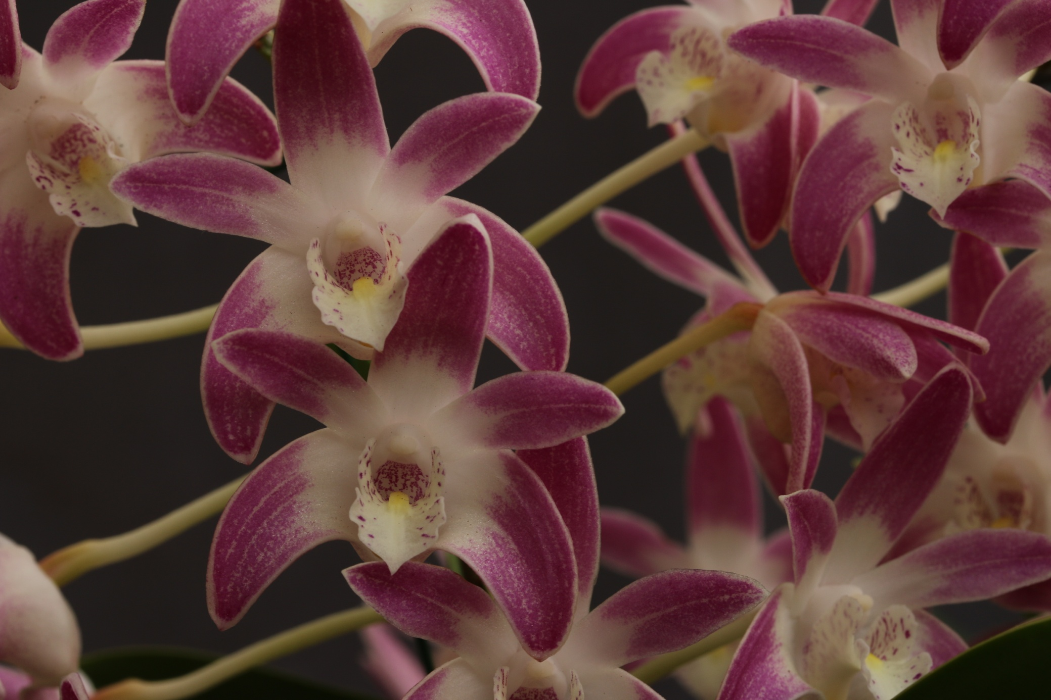

Slide 9
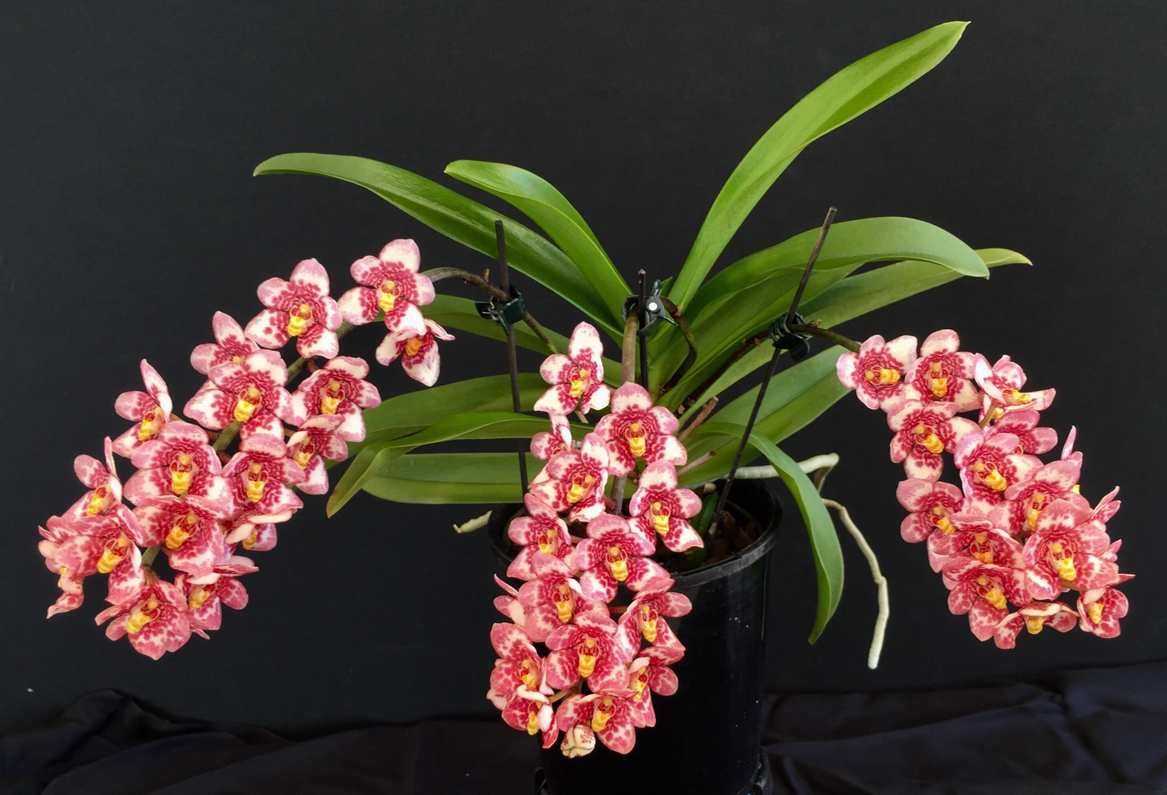
Sarcochilus Evelyn ‘Beenak’
Clive & Agi Halls
AM/OSCOV
80.1

Slide 10
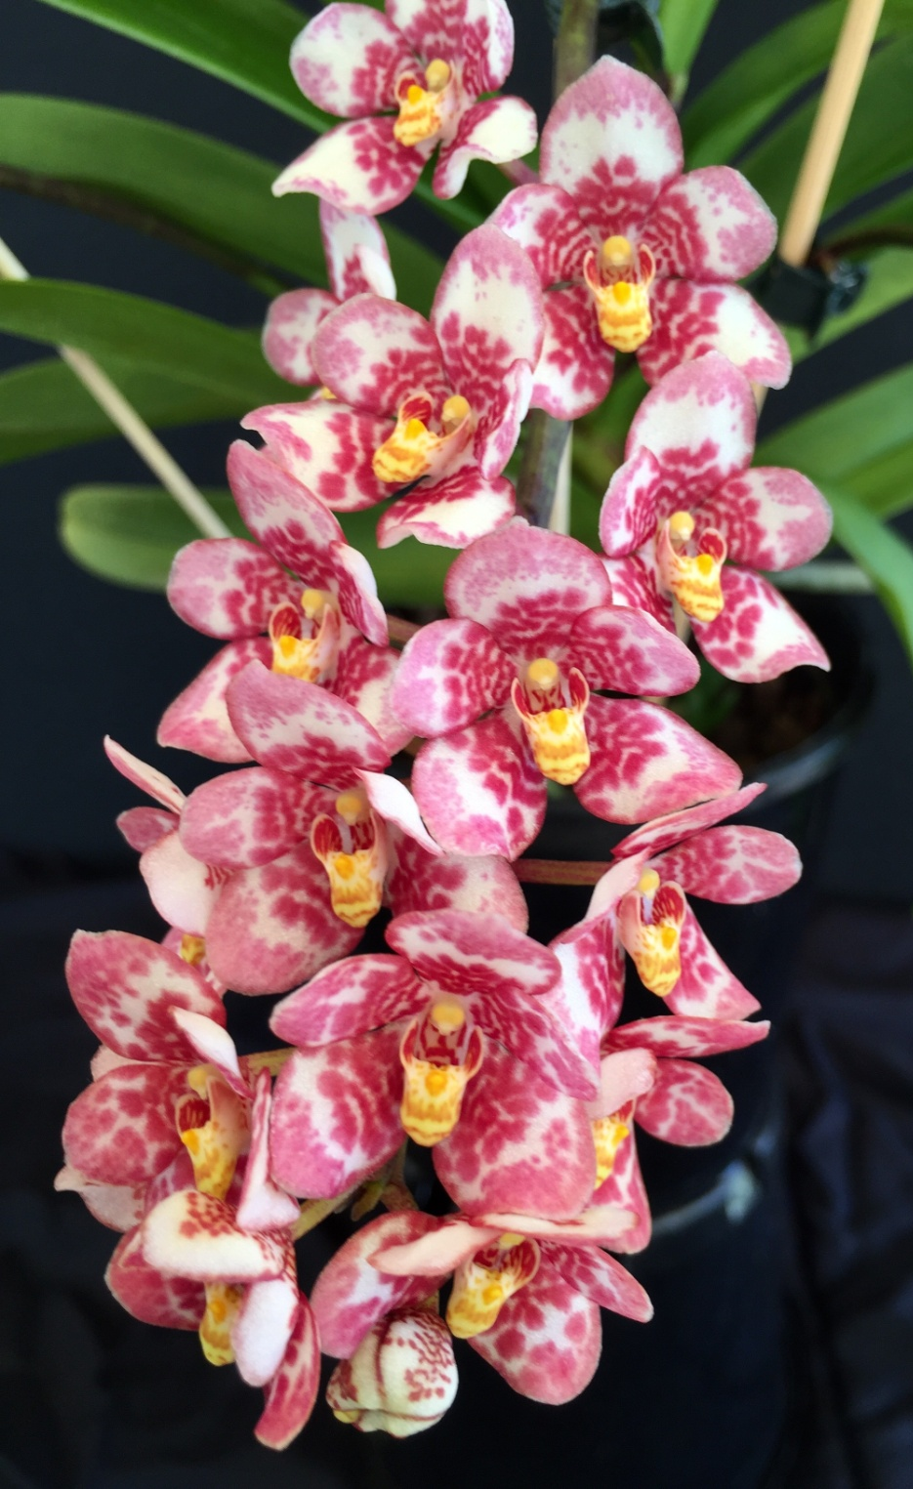

Slide 11
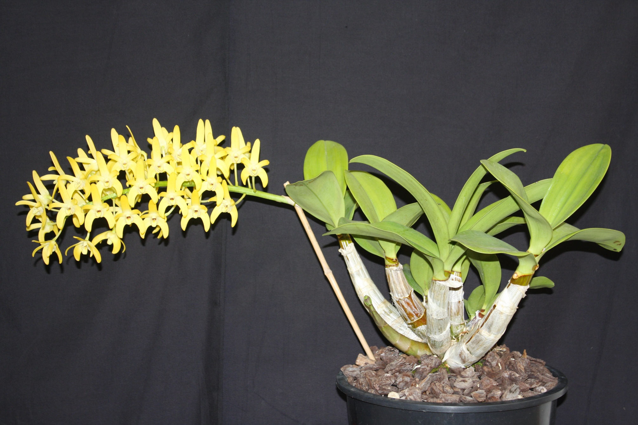
Den. Hulks Moon ‘Alpha’
Chris Pegg
AM/OSCOV
81.3

Slide 12
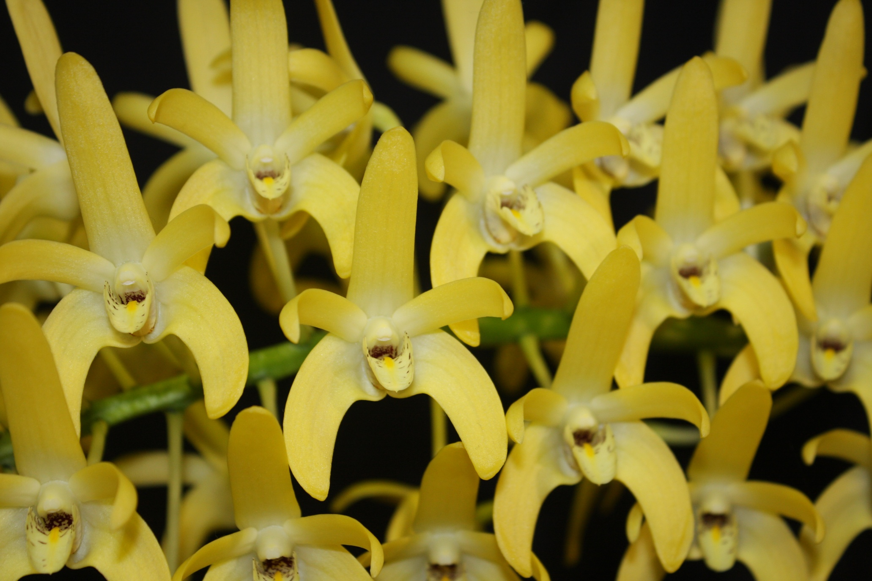

Slide 13
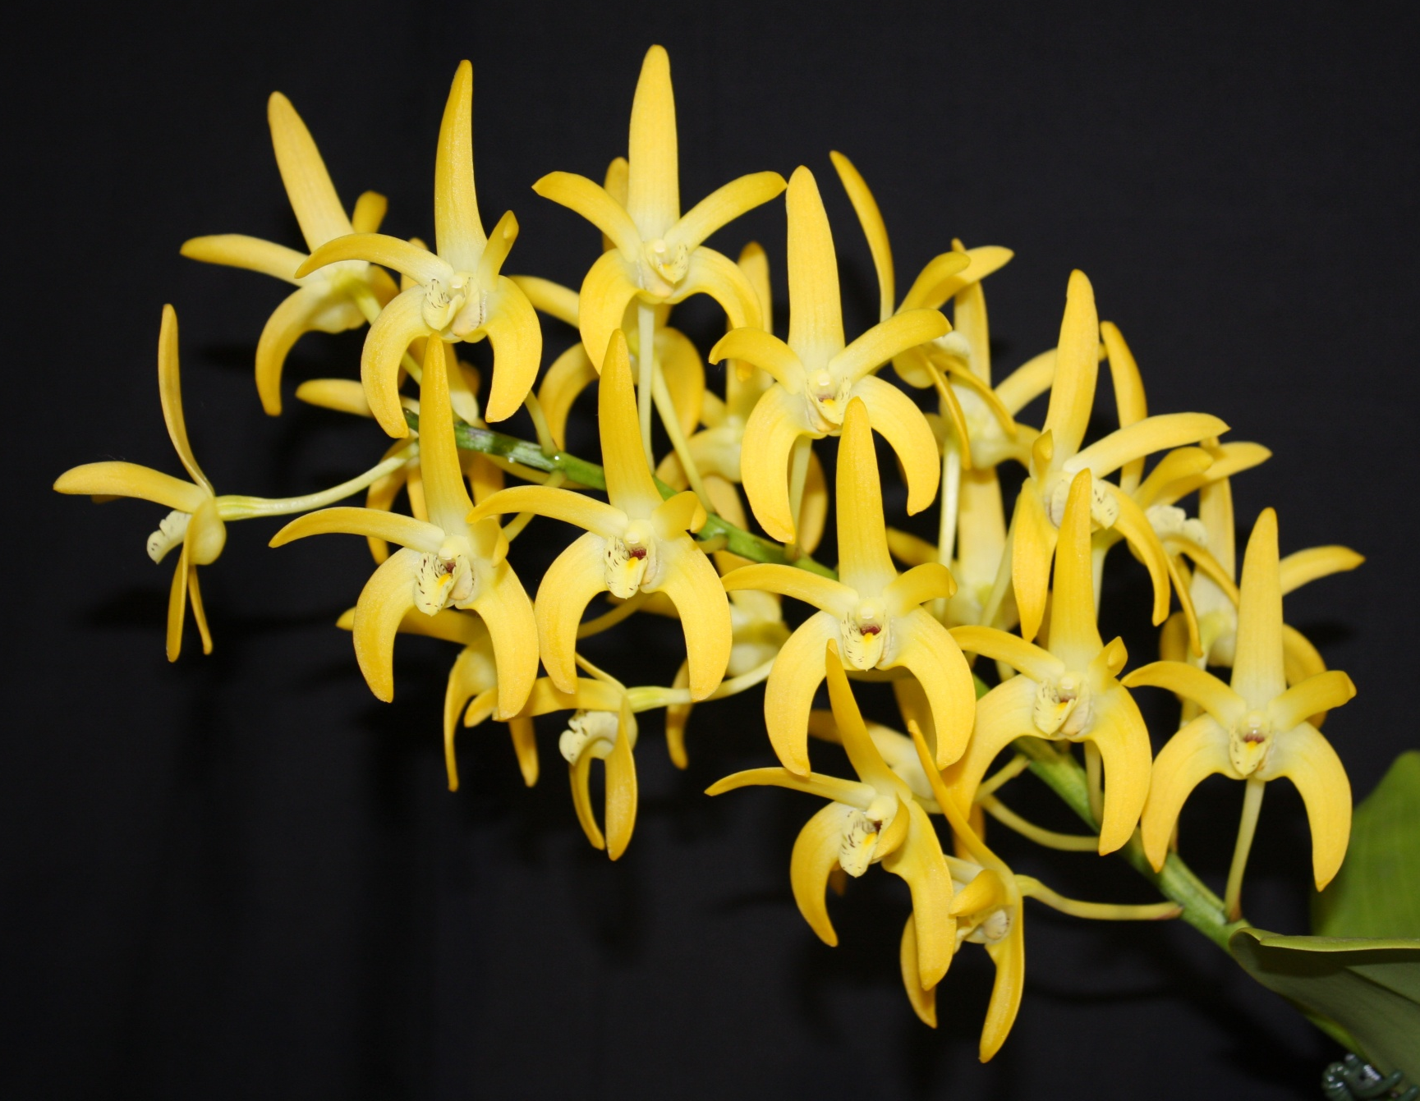
Den. Hulks Moon ‘Bravo’ Chris Pegg
HCC/OSCOV
78.8

Slide 14
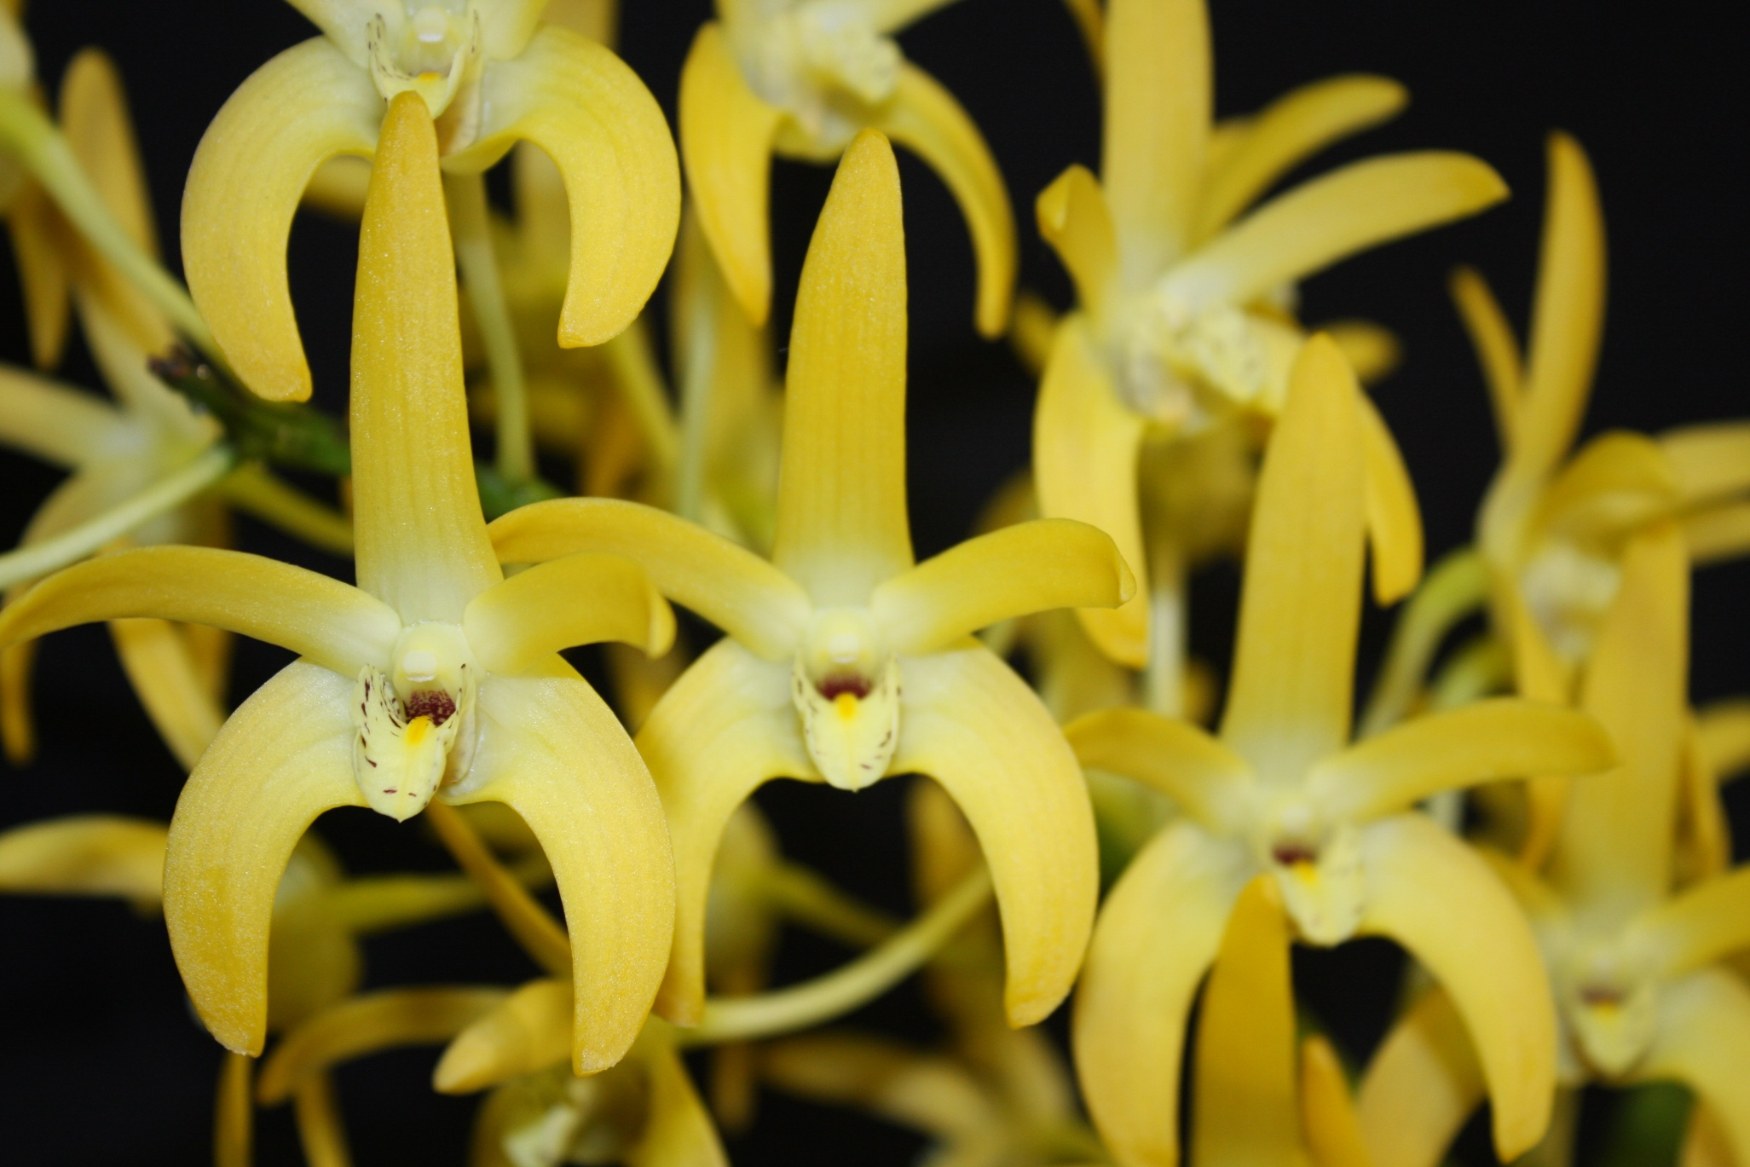

Slide 15
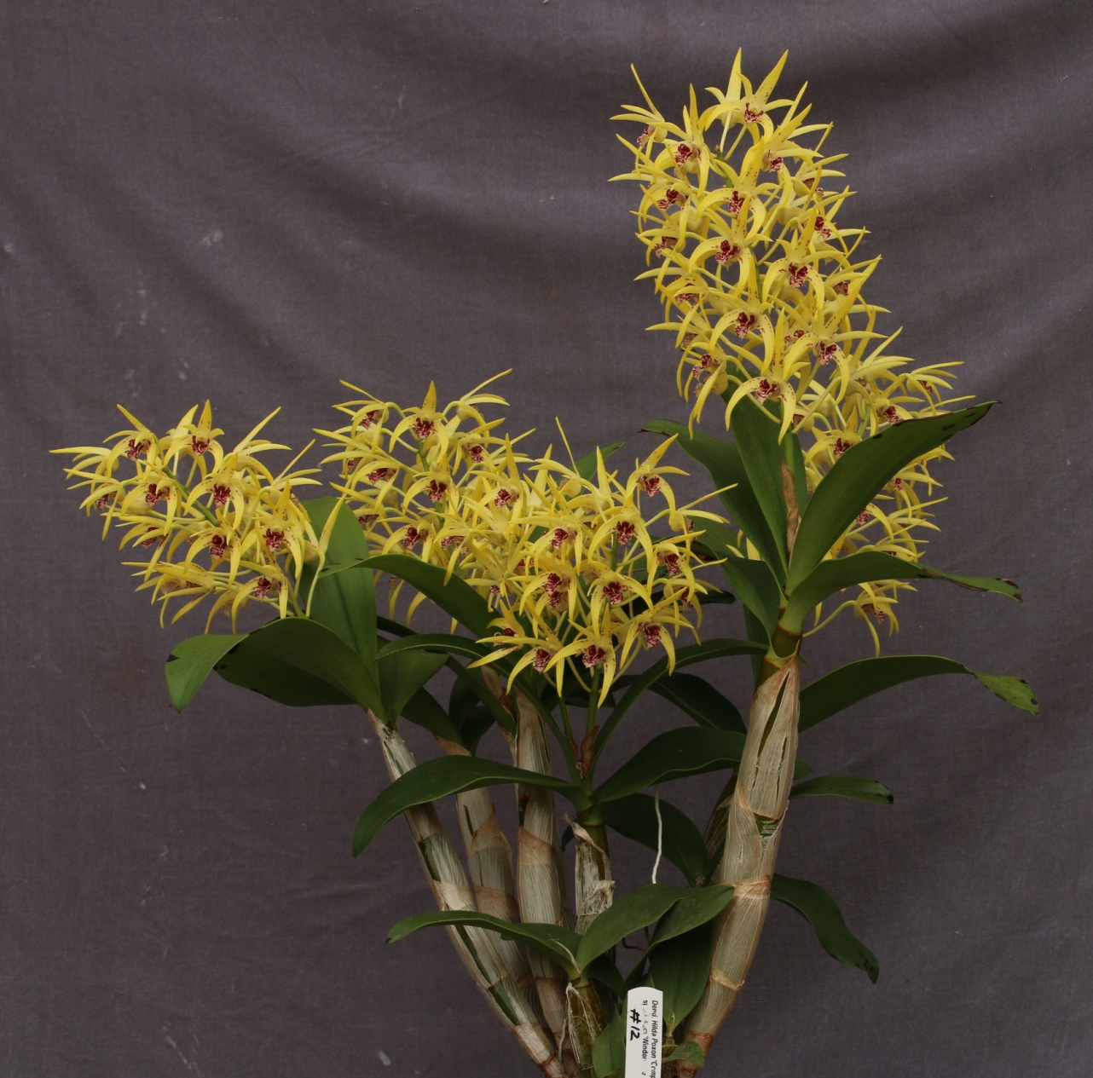
Den. Essie Banks ‘Annie’
Marita Anderson
HCC/OSCOV
77.2

Slide 17
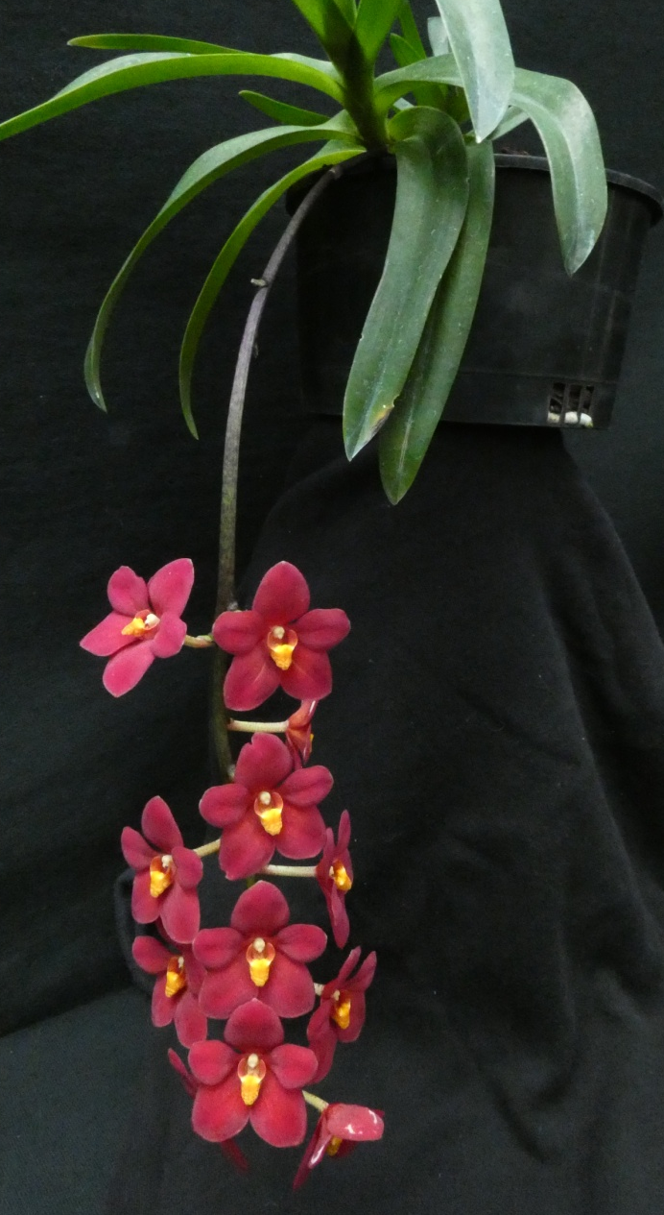
Sarcochilus Allure ‘Demure’
Craig Trainor
HCC/OSCOV
78.7

Slide 18
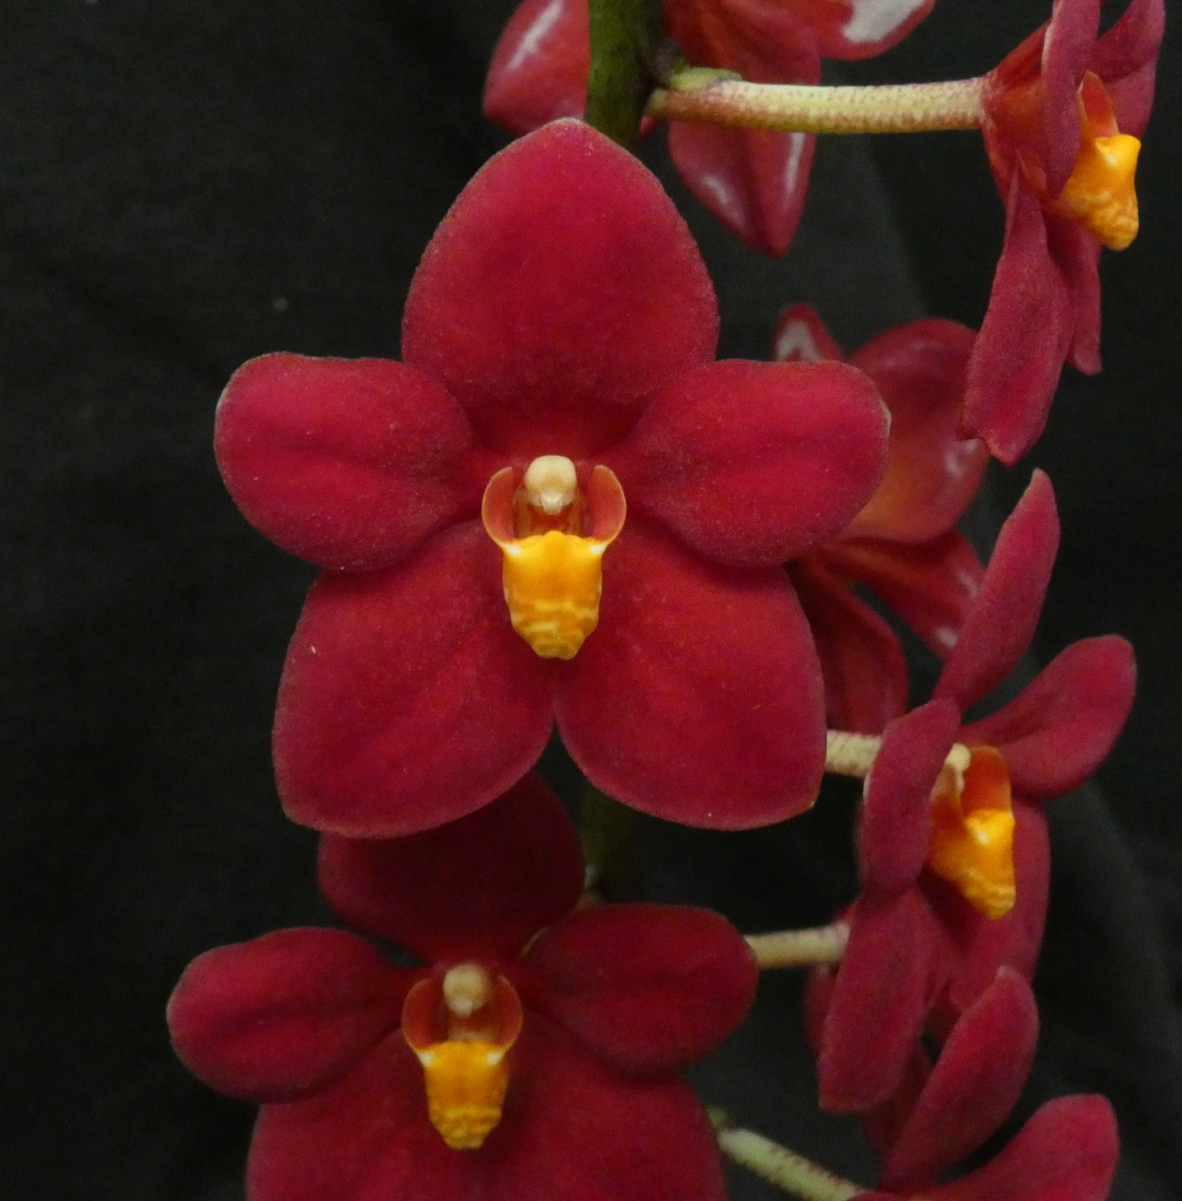

Slide 19
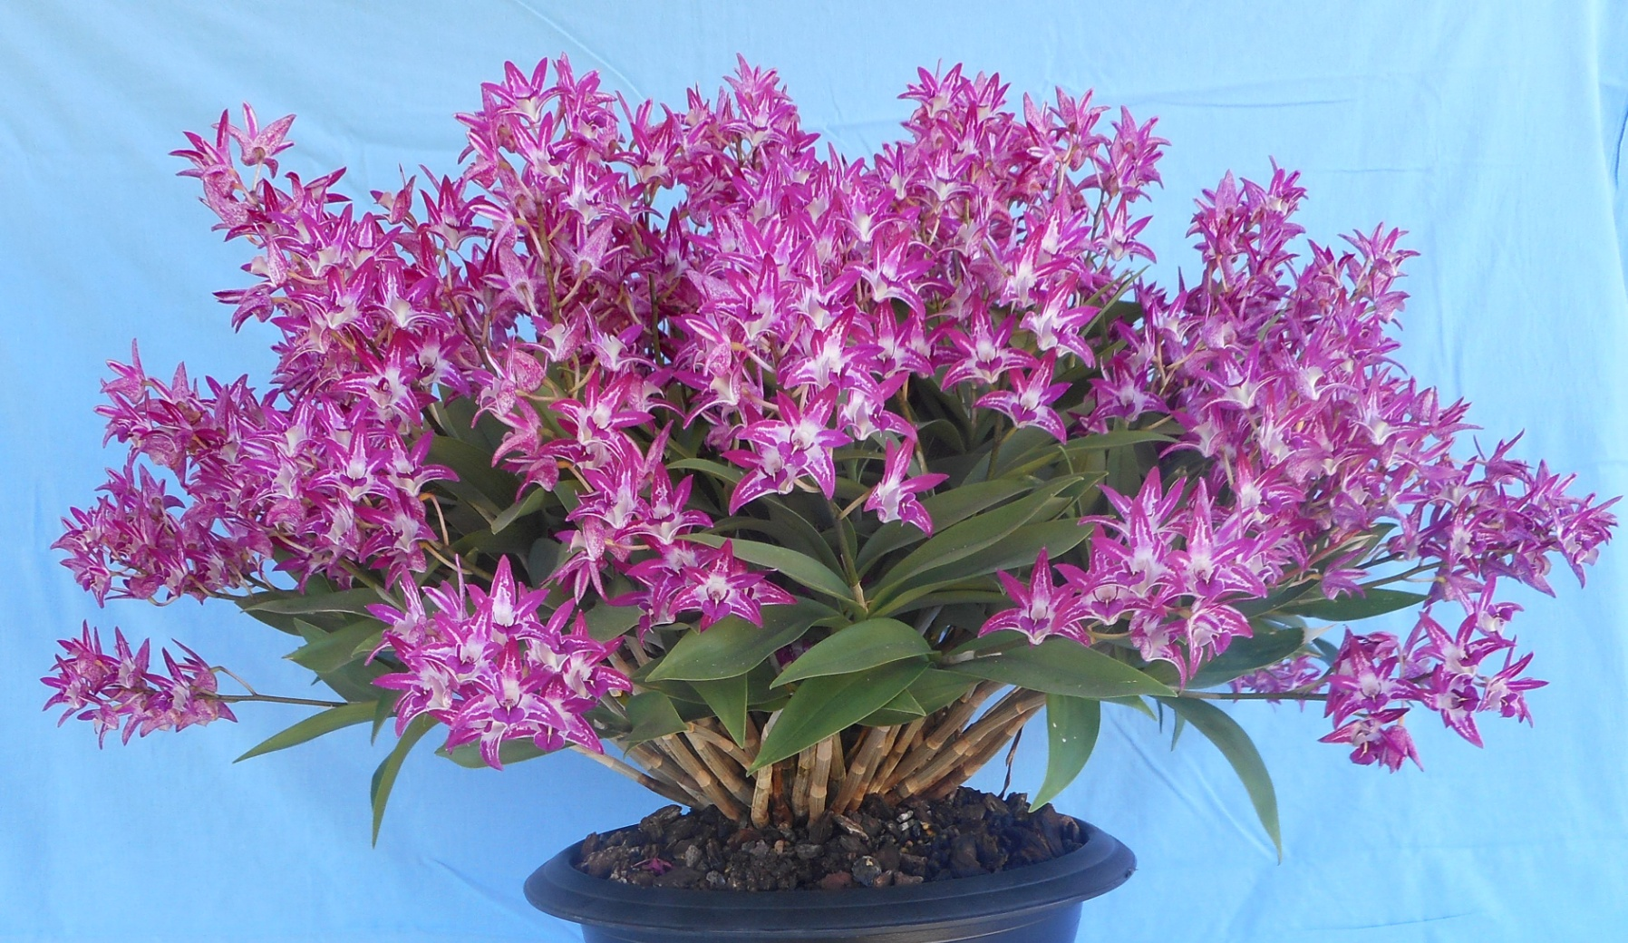
Den. Australian Rhubarb Pie ‘Kahlene’ Daryl Mills
AM/OSCOV
83.0

Slide 20
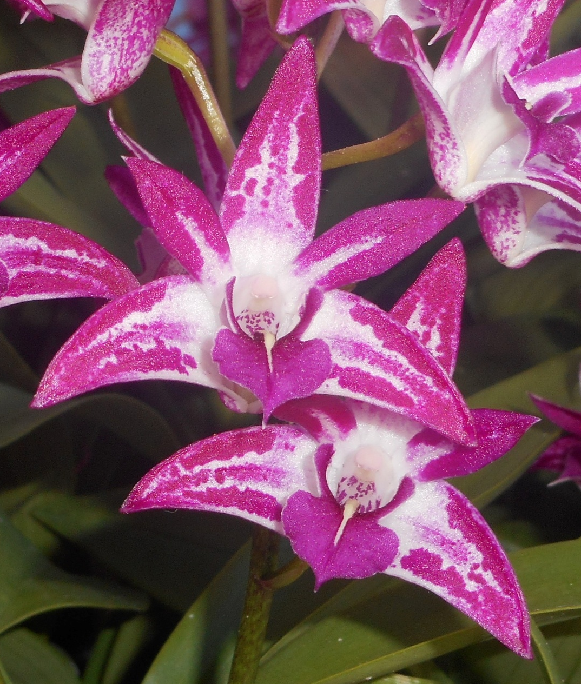

Slide 21
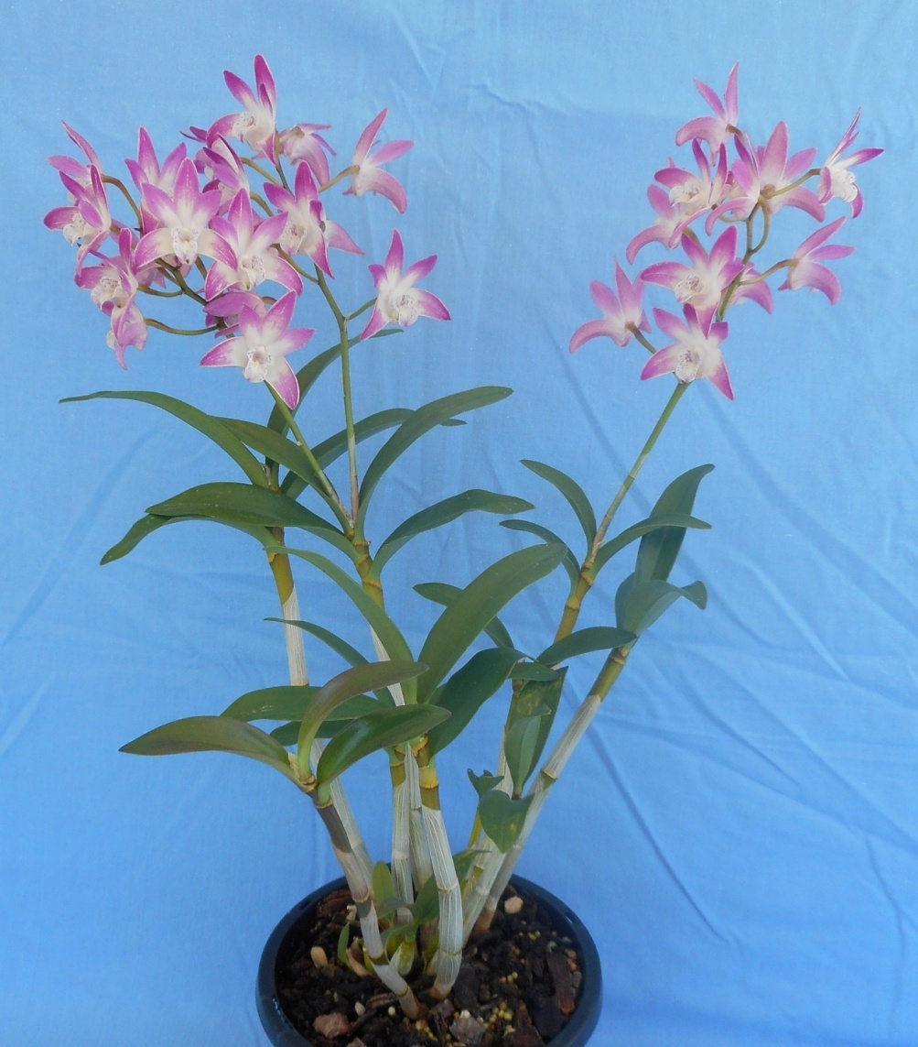
Den. Newbold Rose ‘Eleanor’ Daryl Mills
HCC/OSCOV
79.1

Slide 23
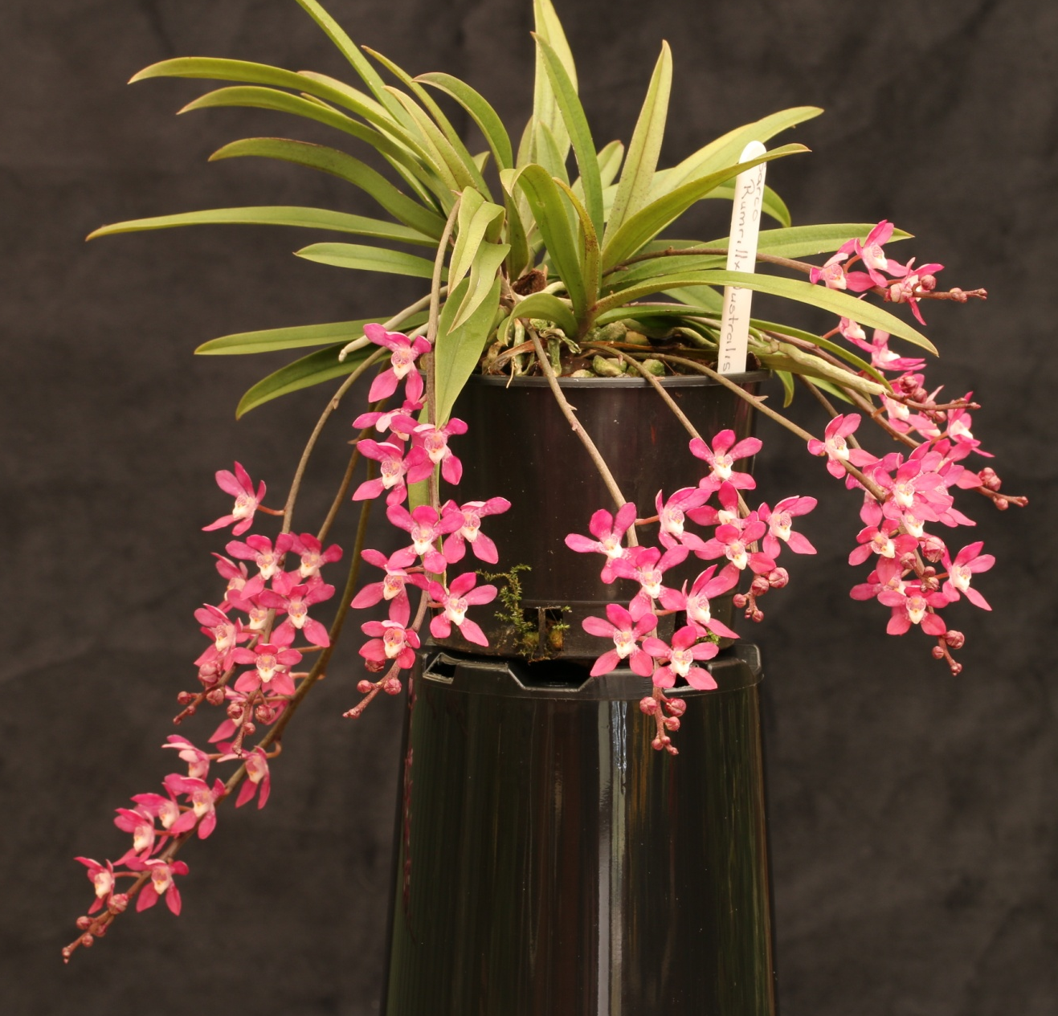
Plectochilus Austral Triumph ‘Eureka’ Marita Anderson
HCC/OSCOV
75.4

Slide 24
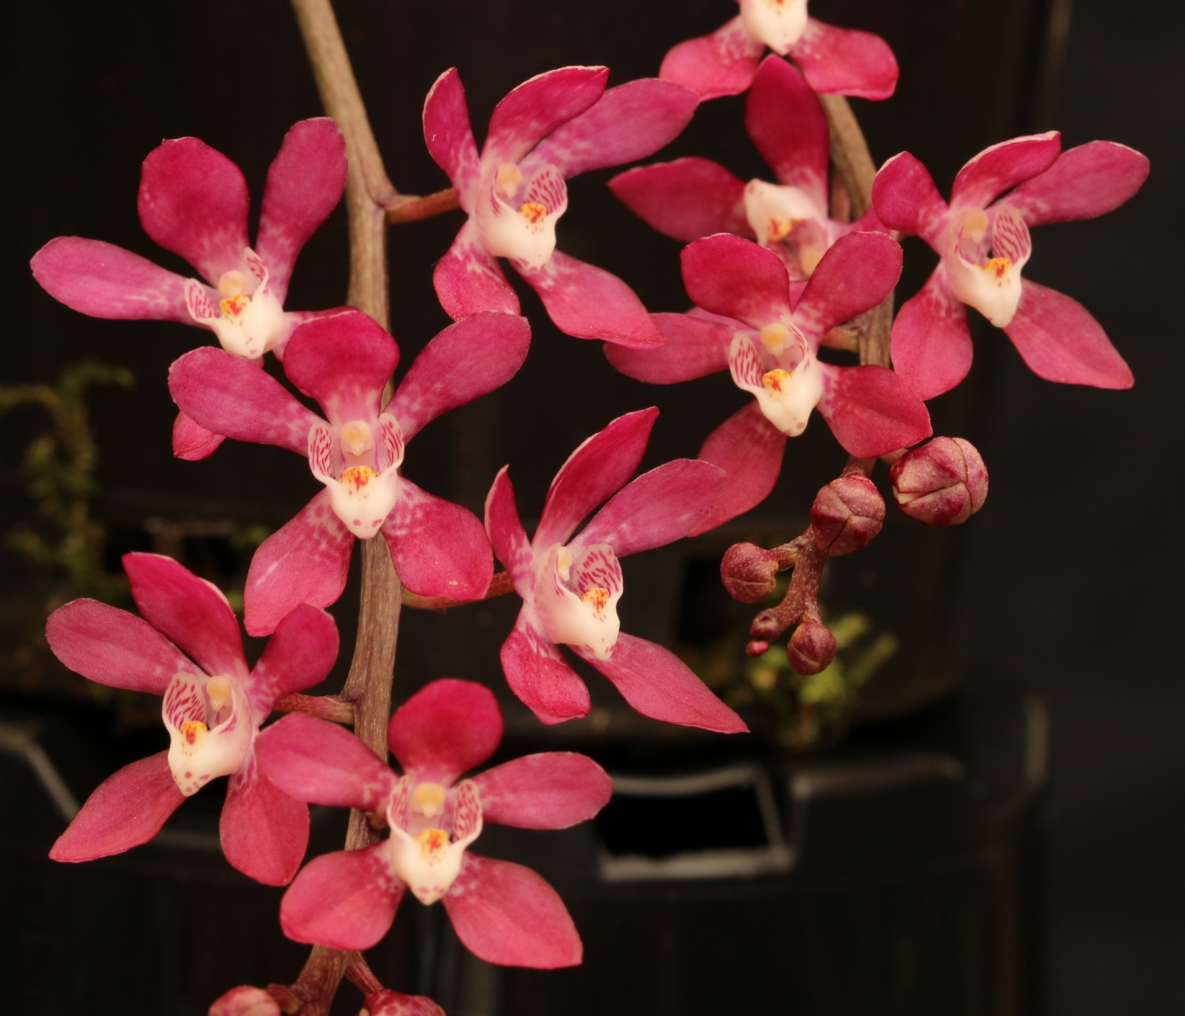

Slide 25
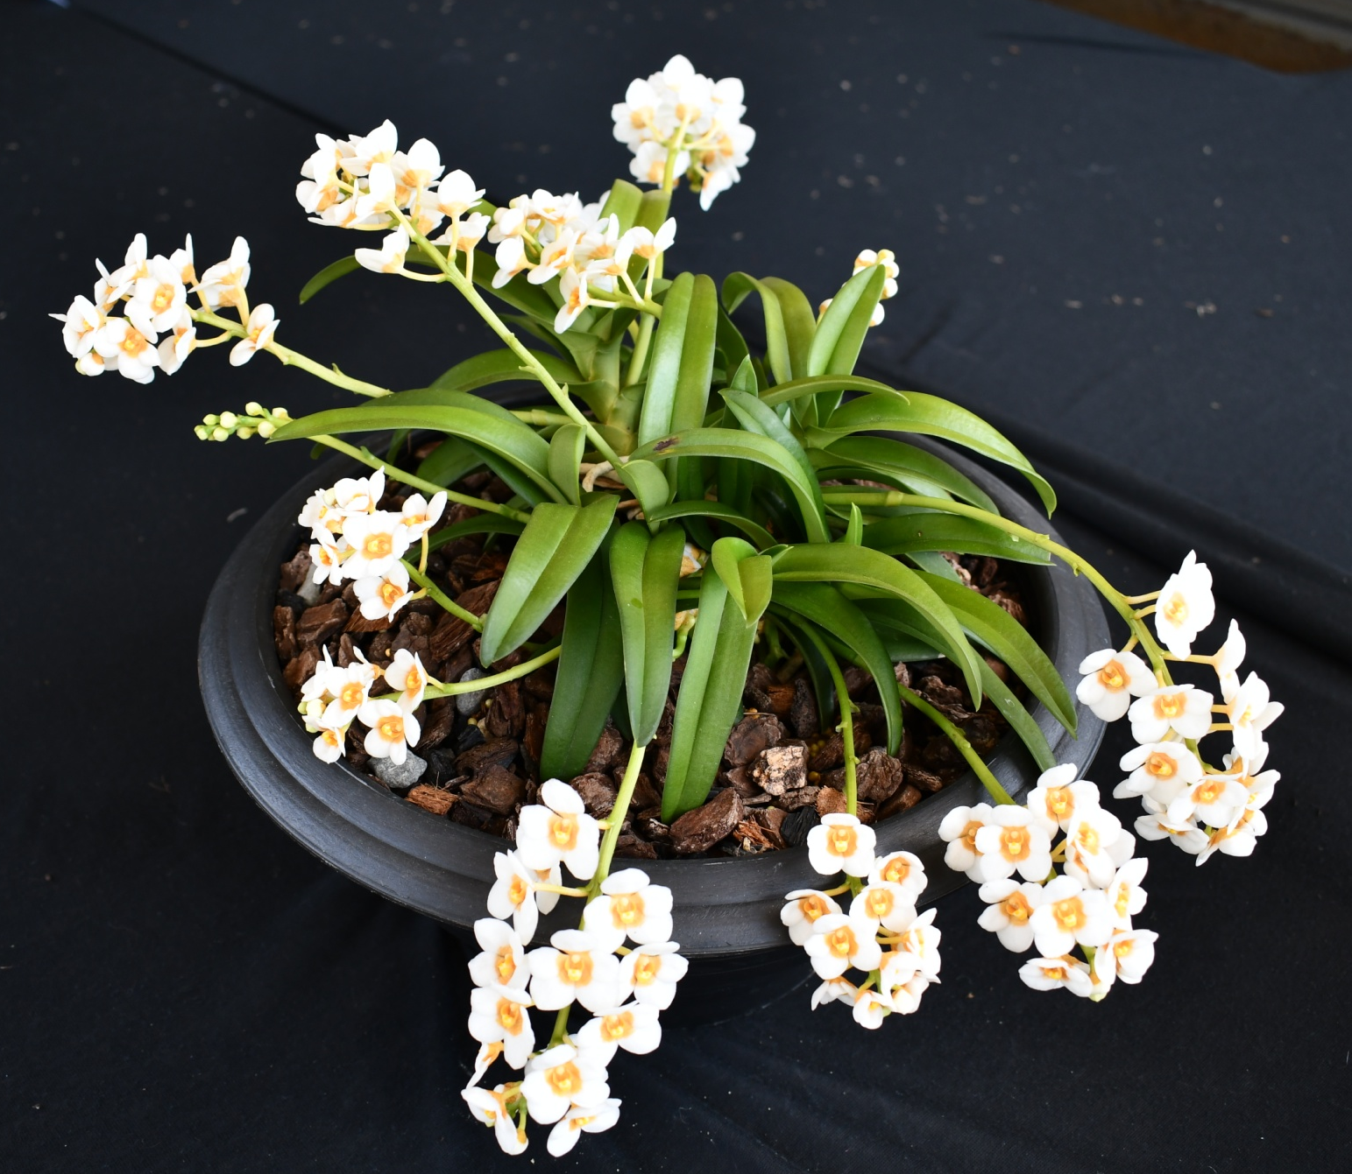
Sarcochilus Myola ‘Nykayl’ Daryl Mills
HCC/OSCOV
77.5
HCC/OSCOV
77.6

Slide 26
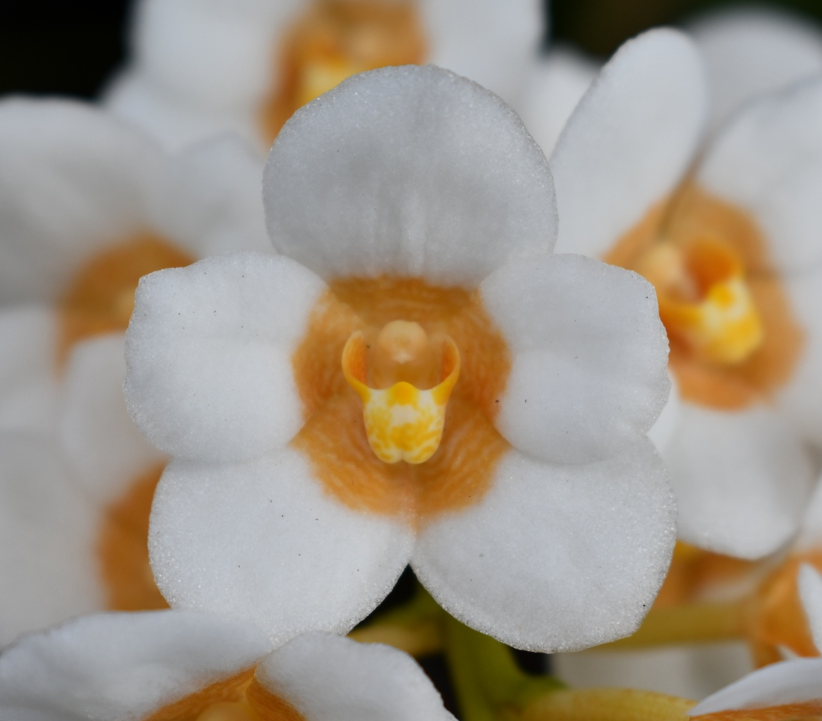

Slide 27
AND THE WINNER IS . . .

Slide 28
Den. Bav’s Beauty ‘RACB’
Robin Bavinton

Slide 29
AUSTRALIAN NATIVE
Species ORCHID
Sponsored by
Yarra Valley Orchid Society

Slide 30
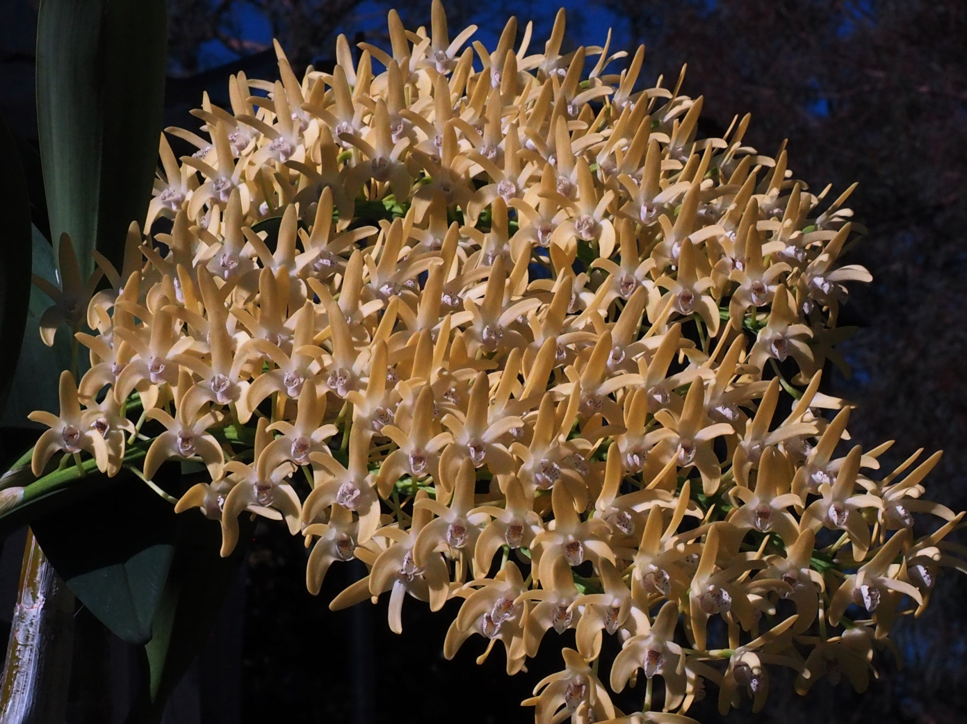
Dendrobium speciosum ‘Daylight Moon’ Murray Harding & Di Lester
AM/OSCOV
80.9

Slide 31
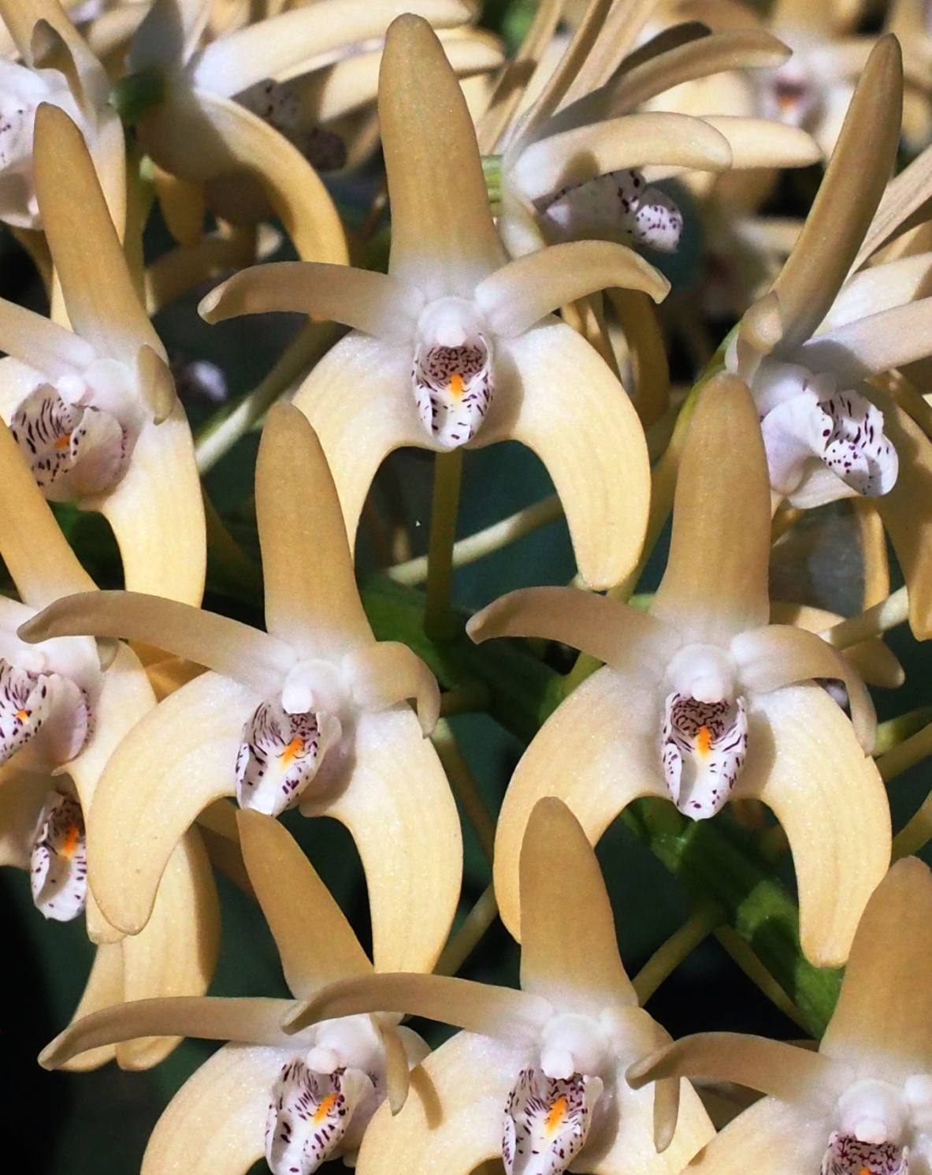

Slide 32
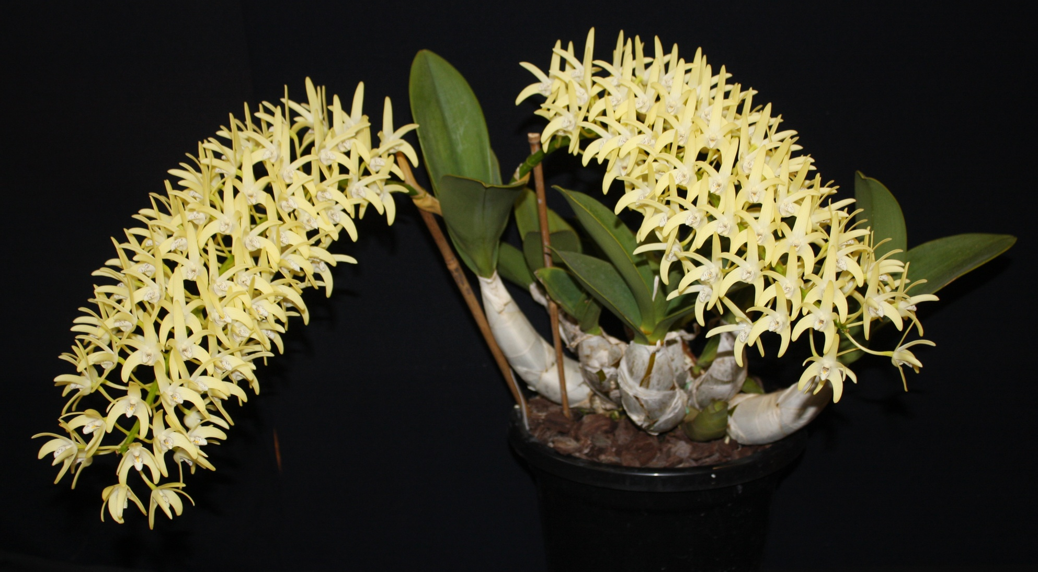
Dendrobium speciosum ‘Anna’ Chris Pegg
AM/OSCOV
81.2

Slide 33
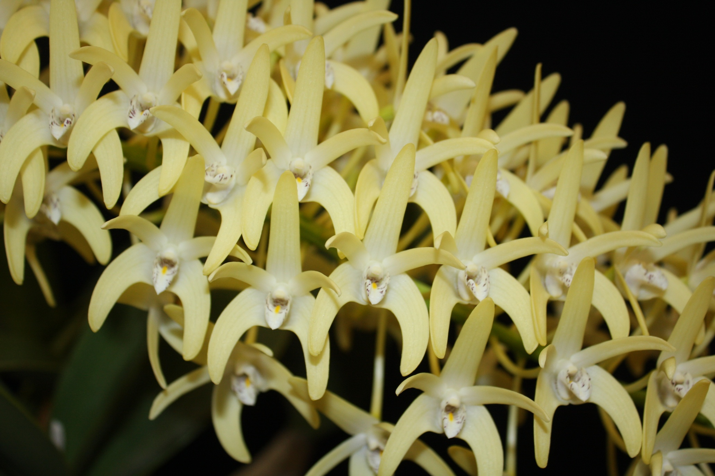

Slide 34
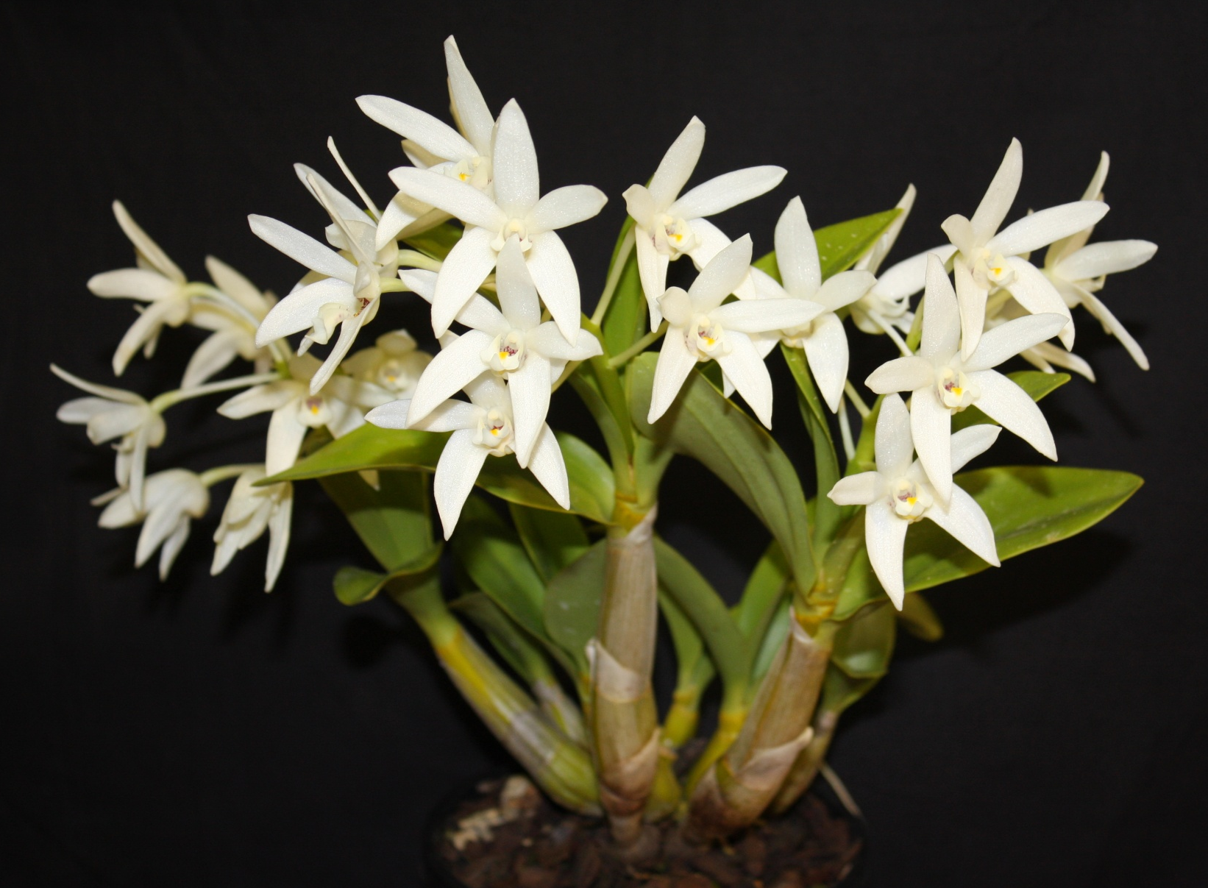
Dendrobium falcorostrum ‘Madison’ Chris Pegg
HCC/OSCOV
78.2

Slide 36
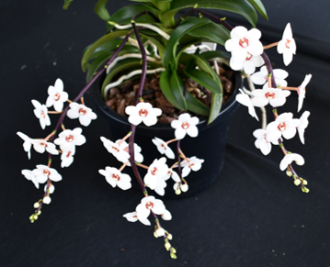
Sarcochilus hartmannii ‘Red Doc’ Daryl Mills
HCC/OSCOV
79.9

Slide 38
Dendrobium speciosum var. curvicaule ‘Lorraine’ D. Bradshaw
HCC/OSCOV 76.8

Slide 39
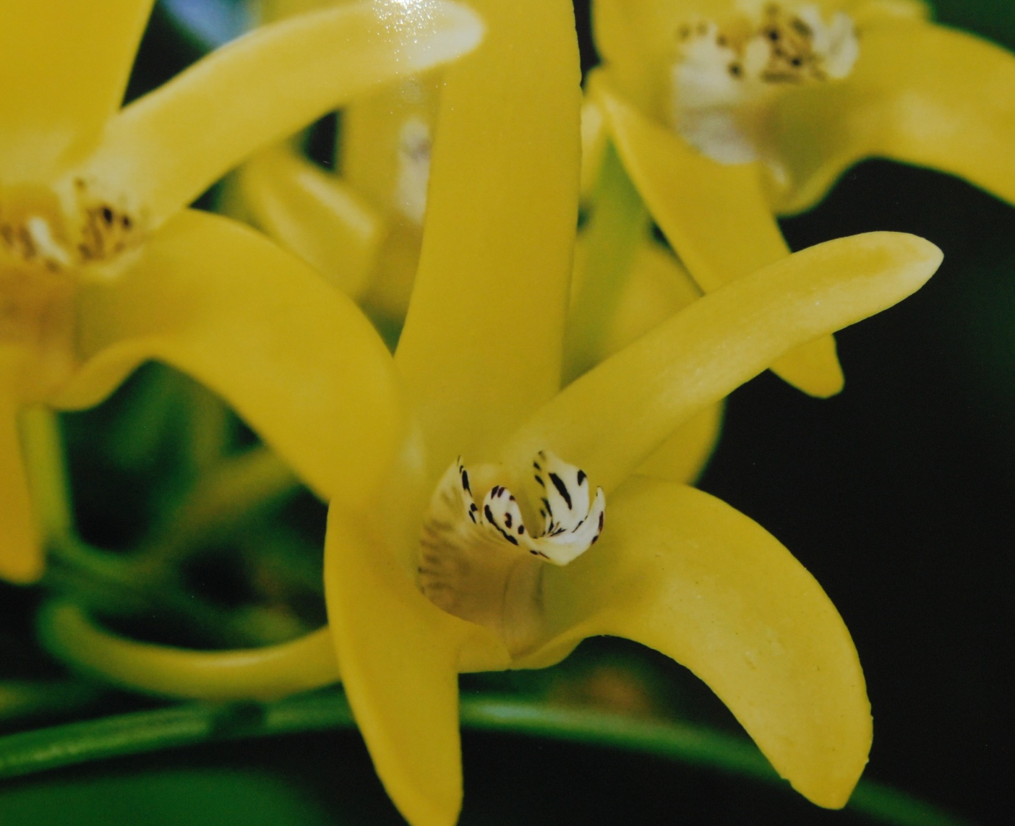

Slide 40
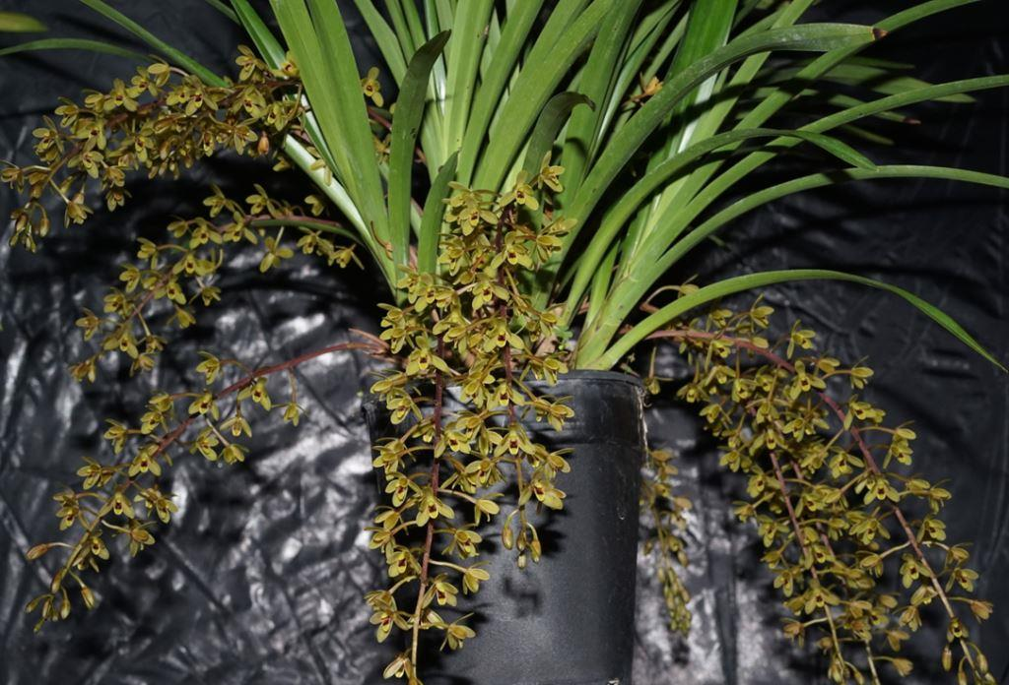
Cymbidium suave Ken Stewart

Slide 41
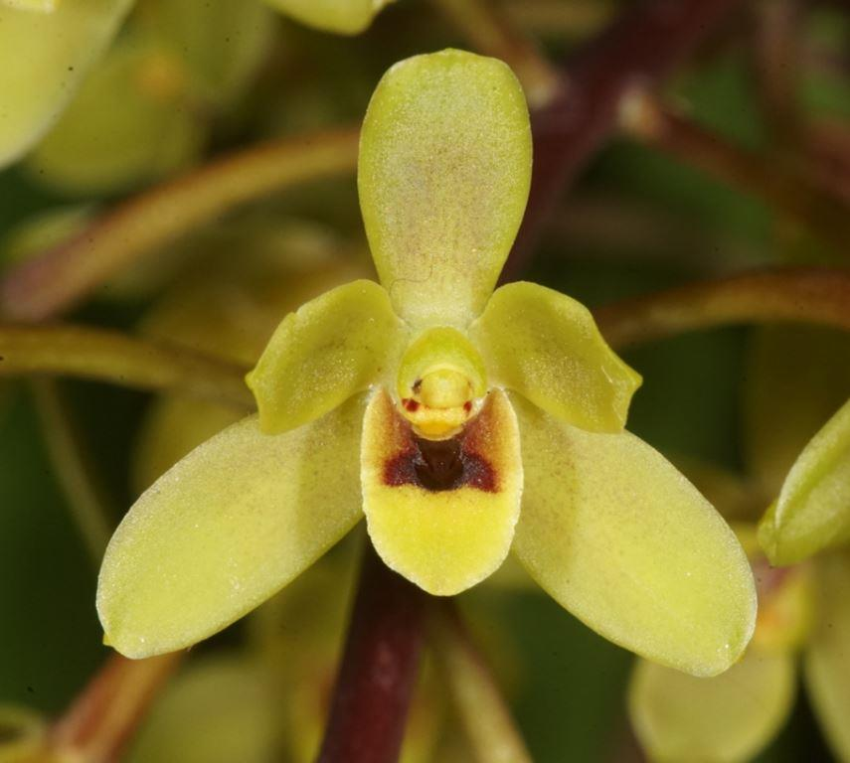

Slide 42
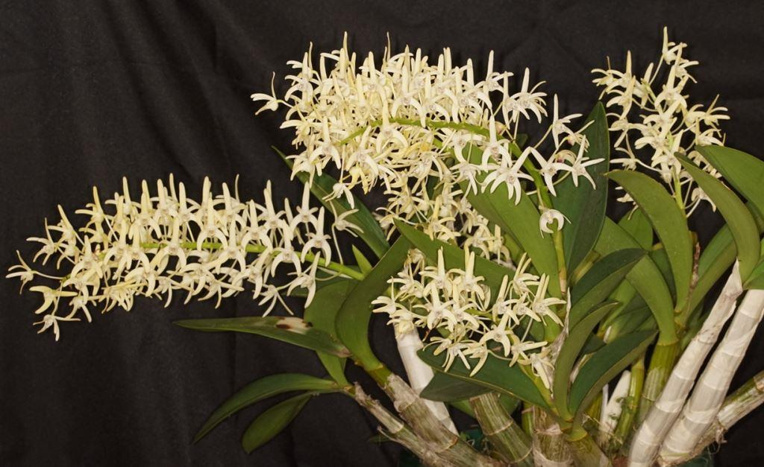
Dendrobium speciosum Ken Stewart

Slide 43
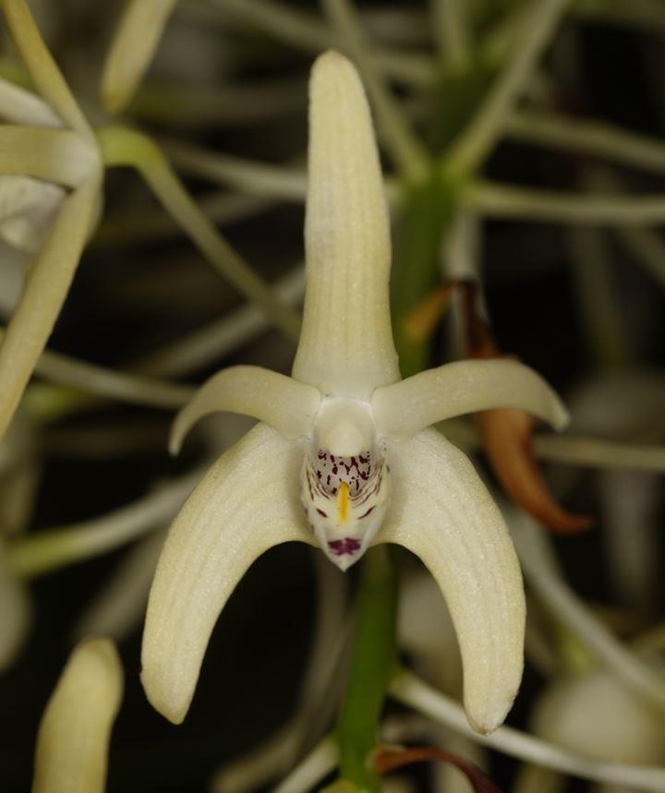

Slide 44
AND THE WINNER IS . . .

Slide 45
Sarcochilus hartmannii ‘Red Doc’ Daryl Mills

Slide 46
cymbidium hybrid ORCHID
Sponsored by the
Cymbidium Society of Victoria

Slide 47
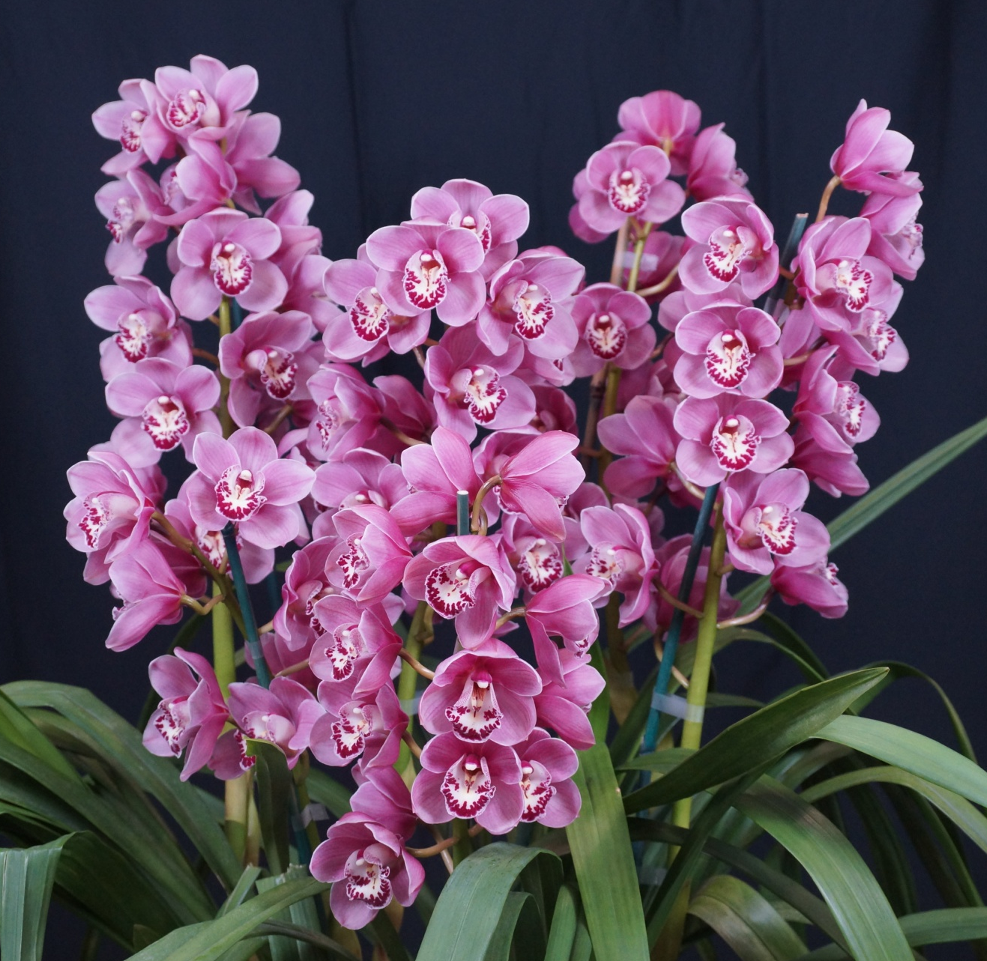
Cym. Khanebono ‘Jacinta’ Terry Poulton
AM/OSCOV 80.3

Slide 49
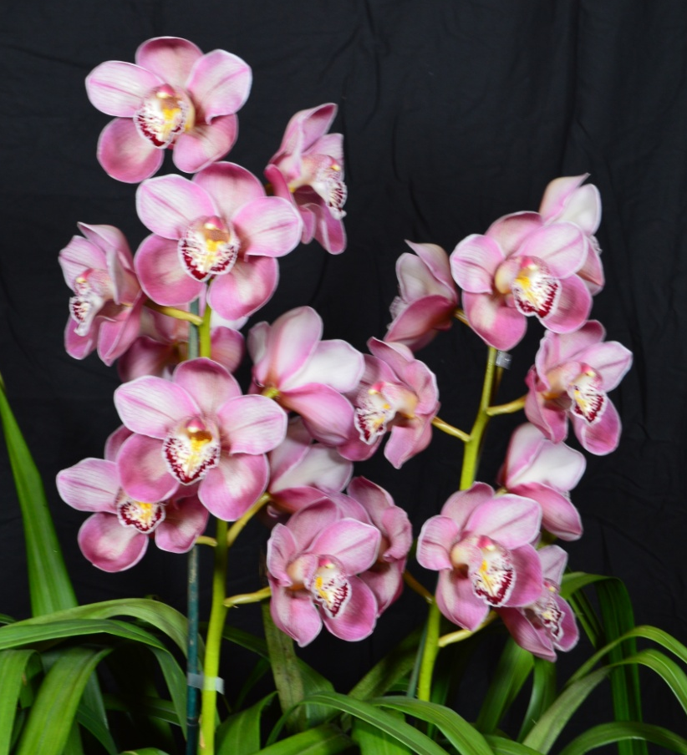
Cym. Laramie Lady ‘Strawberry Fields’ Terry Poulton
HCC/OSCOV
79.9

Slide 50
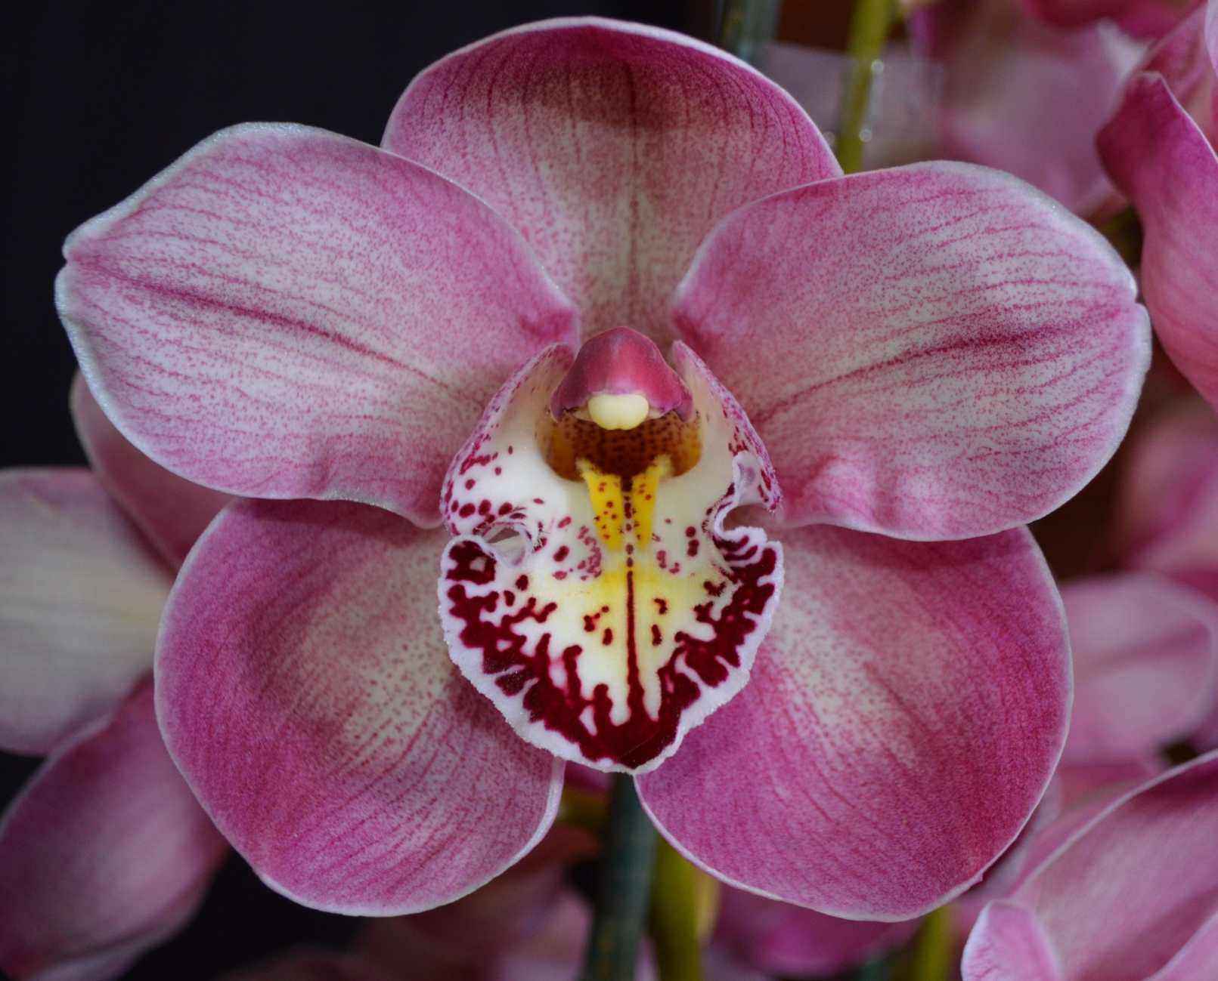

Slide 51
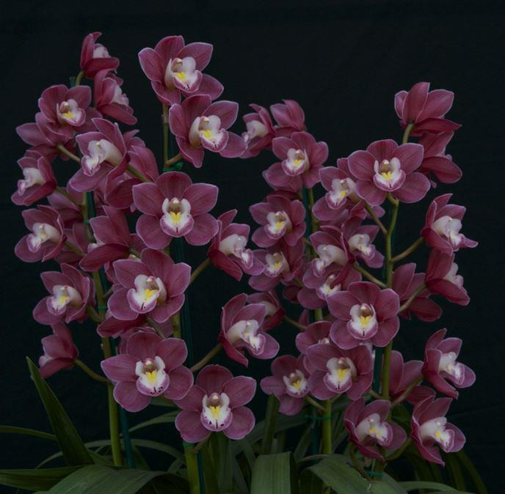
Cym. Templestowe’s Charm ‘Nicole’ David Wain
AM/OSCOV
82.5

Slide 53
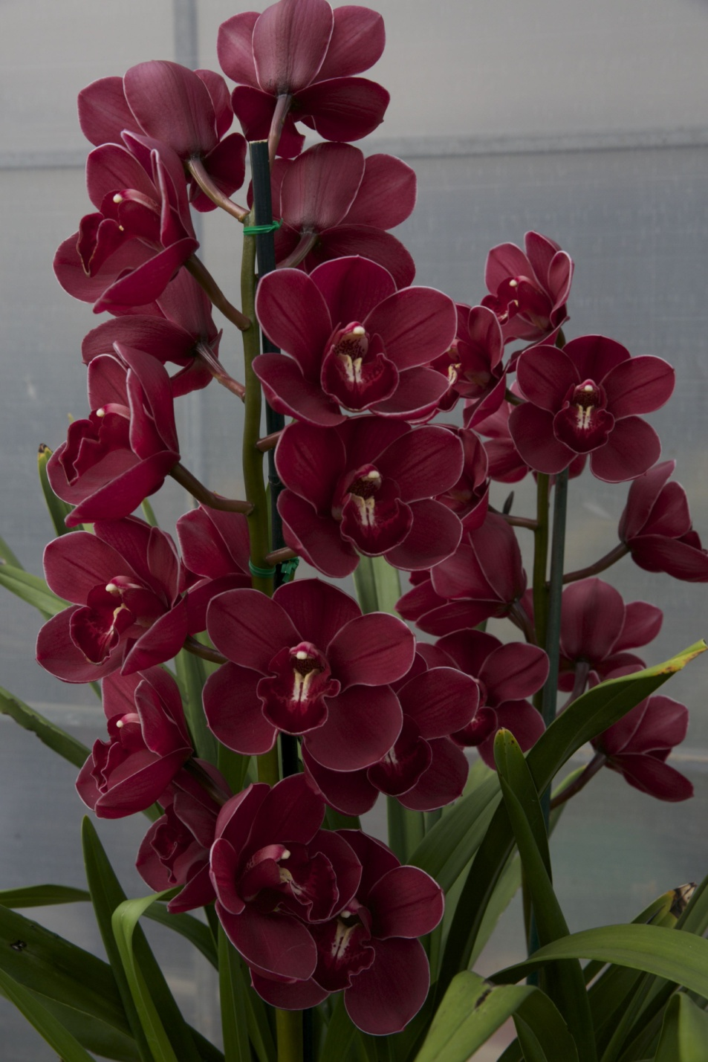
Cymbidium Regal Flames ‘Queen of Hearts’ David Wain
AM/OSCOV
81.1

Slide 54
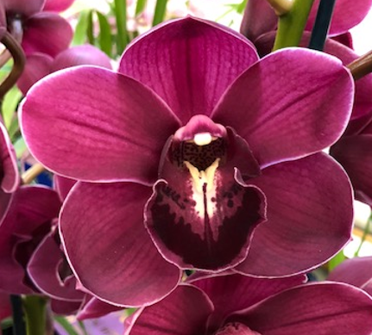

Slide 55
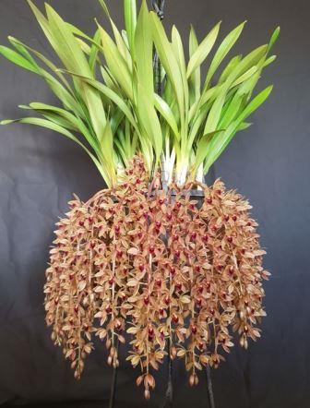
Cym. Sweet Devon ‘J & E’ H. & T. Truong
AM/OSCOV
81.0

Slide 56
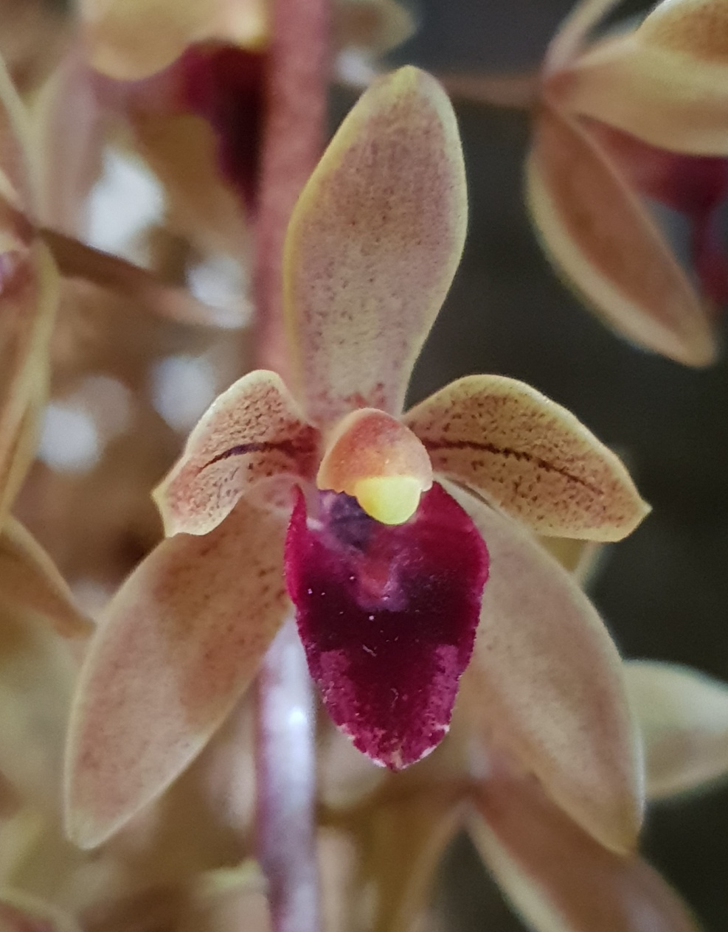

Slide 57
AND THE WINNER IS . . .

Slide 58
Cym. Templestowe’s Charm ‘Nicole’ David Wain

Slide 59
Laeliinae hybrid ORCHID
Sponsored by
Mid-Murray Orchid Society

Slide 60
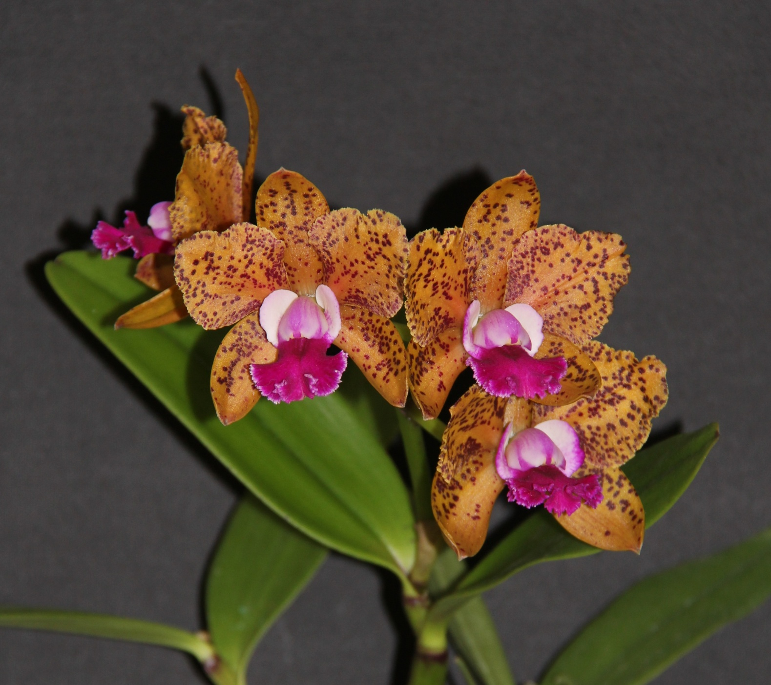
Cattleya Elisabeth Calov ‘Julian’ Michael J. Coker
HCC/OSCOV
76.6

Slide 61
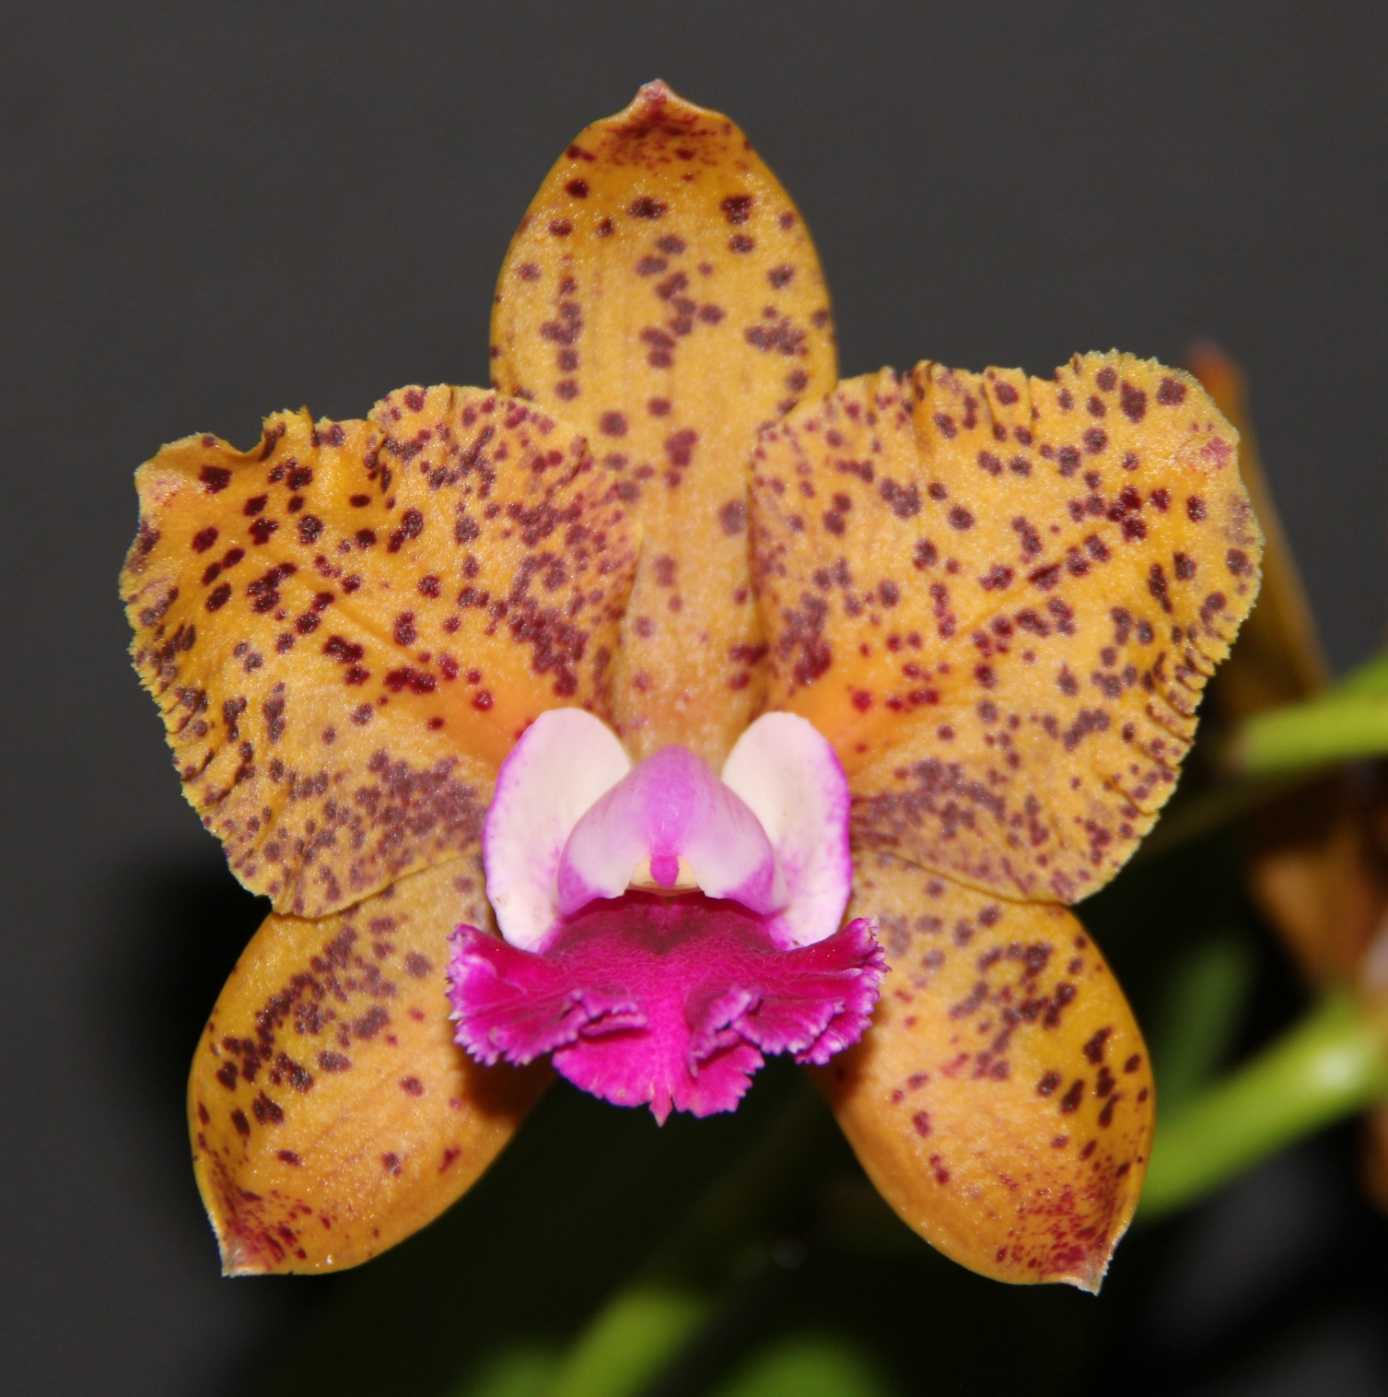

Slide 62
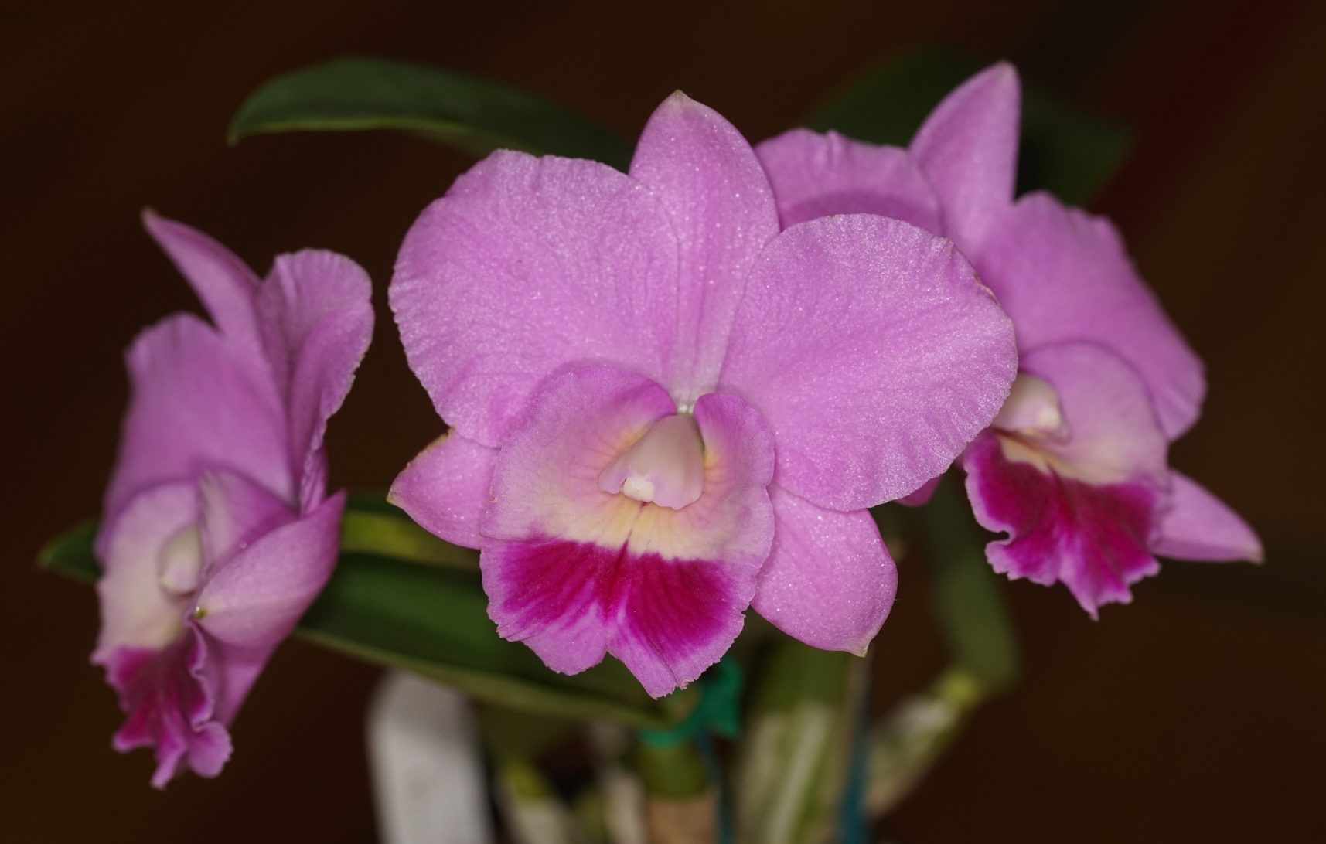
Cattleya Mini Surprise ‘Merrigum’ Castle Creek Orchids
HCC/OSCOV
77.4

Slide 63
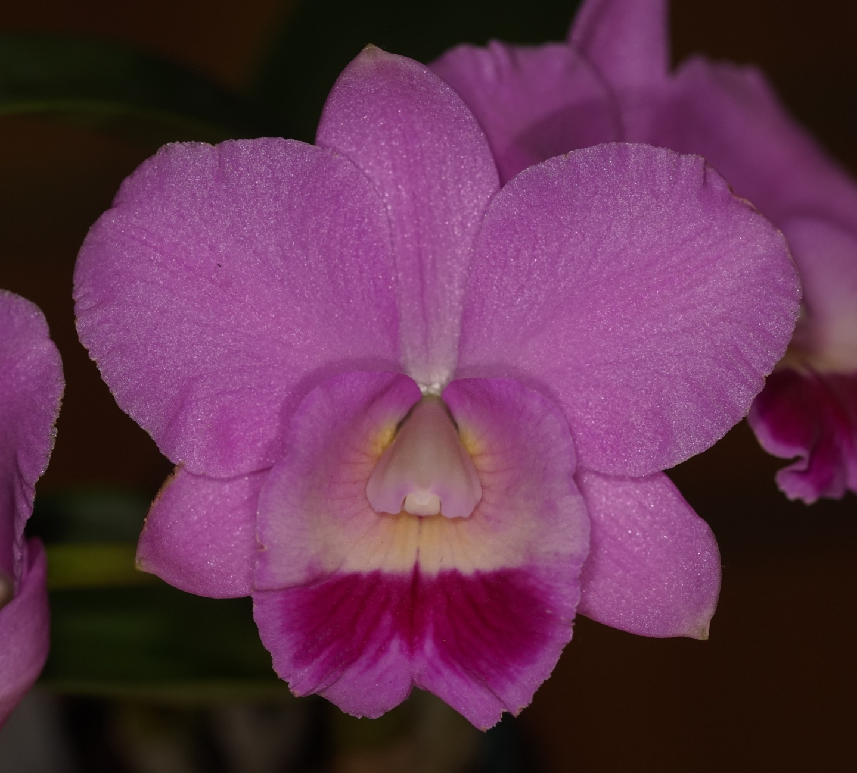

Slide 64
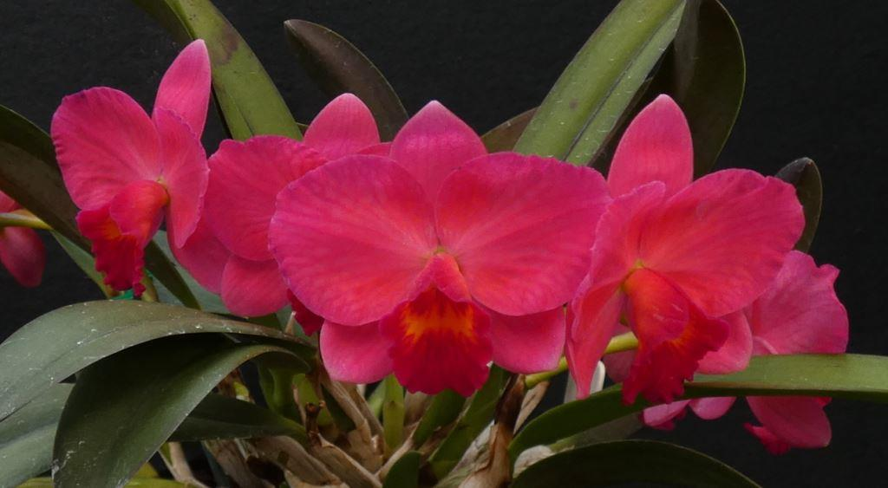
Cattleya Jillian Lea ‘Coral Red’ Craig Trainor
HCC/OSCOV
79.8

Slide 65
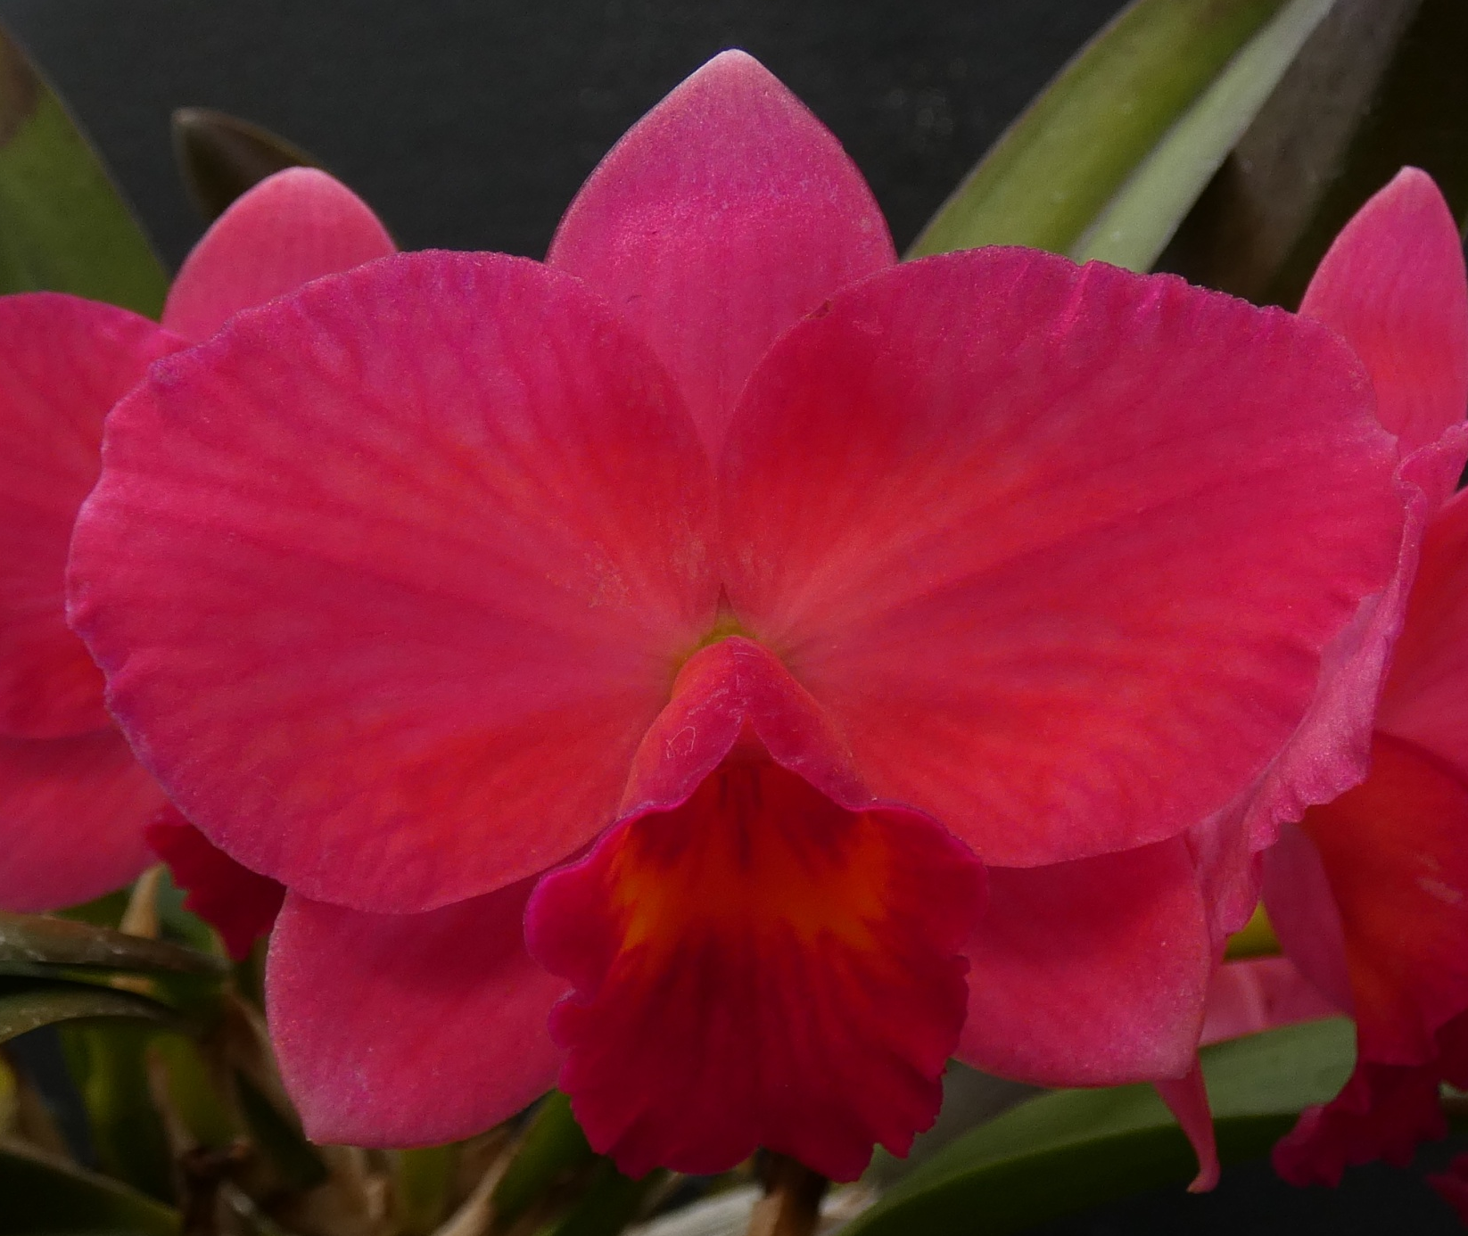

Slide 66
AND THE WINNER IS . . .

Slide 67
Cattleya Jillian Lea ‘Coral Red’ Craig Trainor

Slide 68
Masdevallia hybrid ORCHID
Sponsored by
Warrnambool & District Orchid Society

Slide 69
Masdevallia Supernova ‘Beenak’ T. Visser
AM/OSCOV
80.8

Slide 70
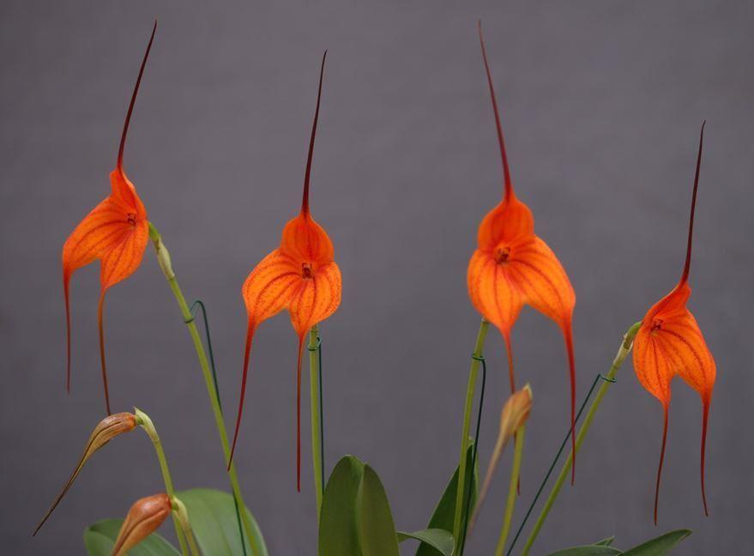
Masdevallia Rein Touch ‘Tangerine Tower’ Marita Anderson
FCC/OSCOV
85.0

Slide 71
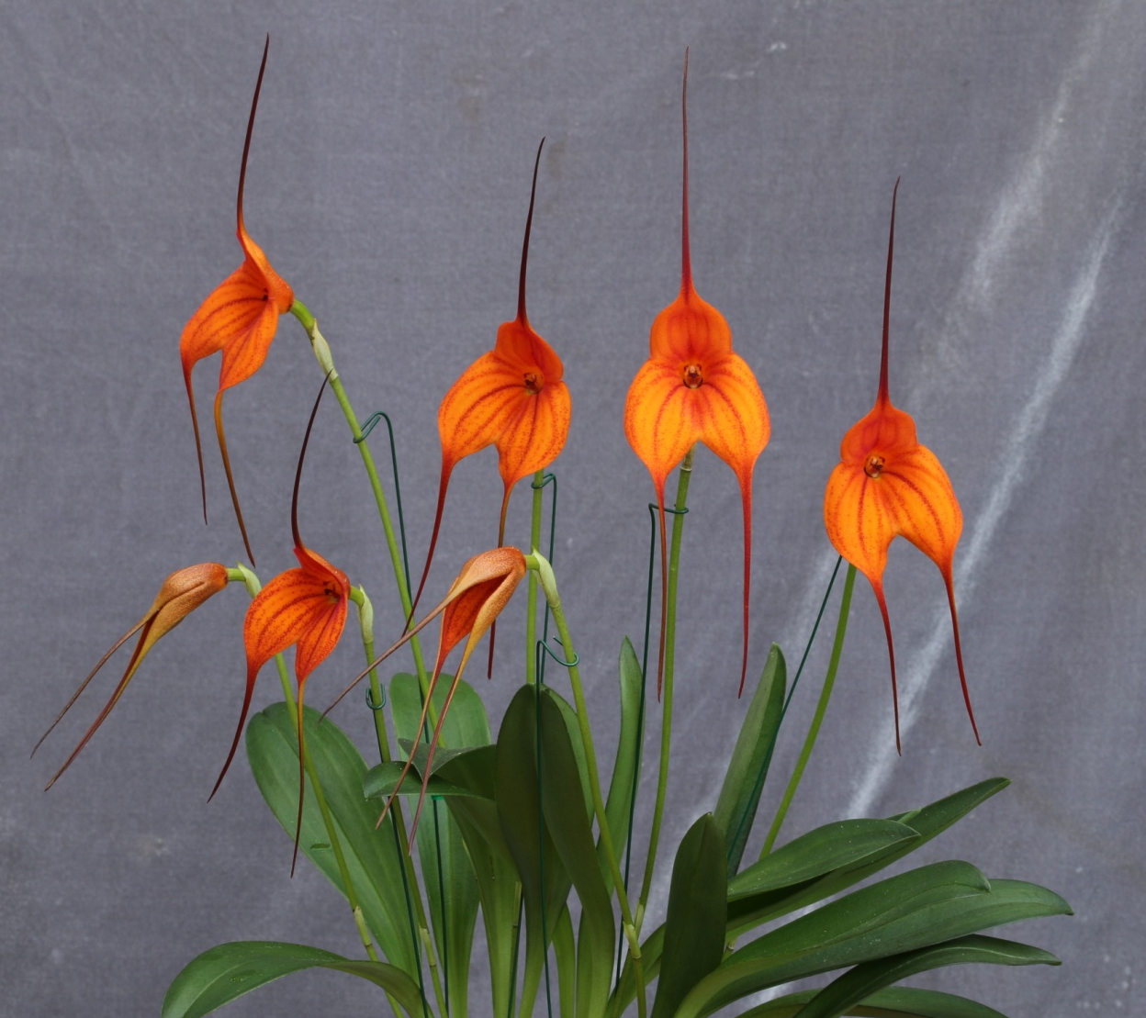

Slide 72
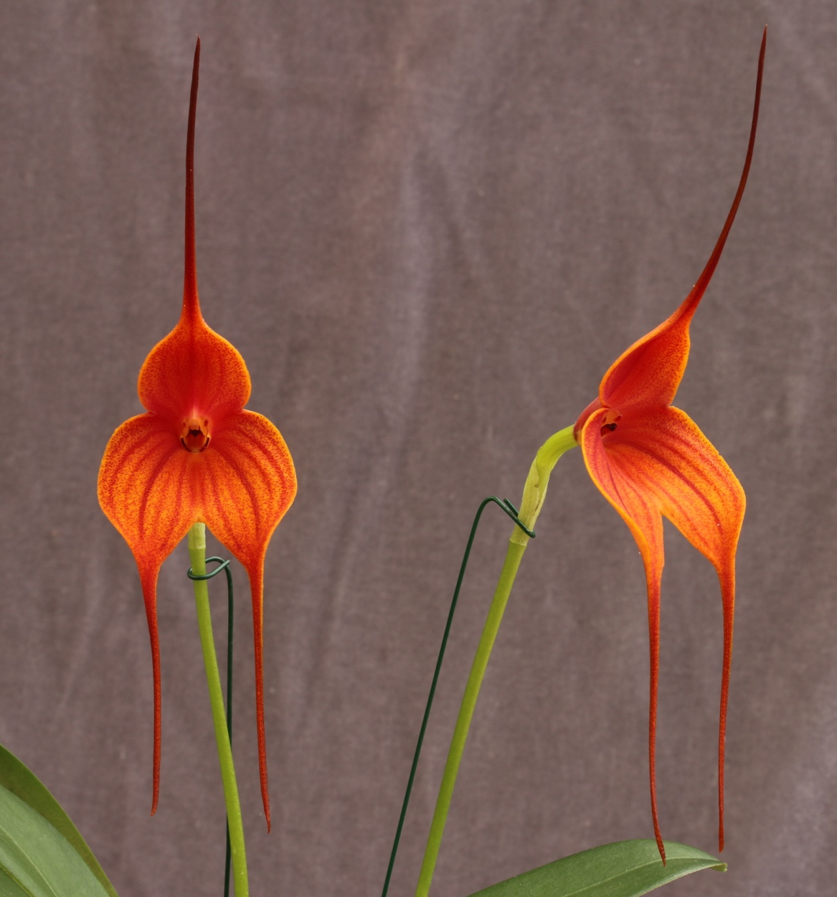
Masdevallia Peppermint Touch ‘Big Boy’ Marita Anderson
HCC/OSCOV
81.6

Slide 73
AND THE WINNER IS . . .

Slide 74
Masdevallia Rein Touch ‘Tangerine Tower’ Marita Anderson

Slide 75
oncidiinae hybrid ORCHID
Sponsored by
Bendigo Orchid Club

Slide 76
Miltoniopsis Golden Snows ‘Distinction’ Craig & Fiona Miles
HCC/OSCOV
79.9

Slide 78
Miltoniopsis Golden Snows ‘Globe’ Craig & Fiona Miles
HCC/OSCOV
77.2

Slide 80
Oncostele Midnight Miracles ‘Massai’ Daryl Mills
HCC/OSCOV
78.7

Slide 82
Rhynchostele Stamfordiense ‘Banyena’ Michael & Bernadette Matthews
HCC/OSCOV
77.6

Slide 84
AND THE WINNER IS . . .

Slide 85
Miltoniopsis Golden Snows ‘Globe’ Craig & Fiona Miles

Slide 86
paphiopedilum hybrid ORCHID
Sponsored by
Ballarat Orchid Society

Slide 87
Paph. Black Spider ‘Aries’ Craig & Fiona Miles
AM/OSCOV
80.9

Slide 89
Paph. Picture Rock ‘Sandstone’ Craig & Fiona Miles
HCC/OSCOV
77.5

Slide 91
Paph. Spotted Oak ‘Merrigum’ Craig & Fiona Miles
HCC/OSCOV
77.9

Slide 93
Paph. Saint Maximillian Kolbe ‘Julian’ Michael J. Coker
AM/OSCOV
80.0

Slide 95
Paph. Fanaticum ‘Elfin Green’ Marita Anderson
AM/OSCOV
82.1

Slide 97
Paph. Memoria Barbara Francis ‘Castle Creek’ Craig & Fiona Miles
AM/OSCOV
80.6

Slide 99
Paph. Puppentanz ‘Goldilocks’ Cory Haugh
AM/OSCOV
80.8

Slide 101
Paph. Dark Knight ‘Sukhilicious’ Michael J. Coker
AM/OSCOV
80.4

Slide 103
Paph. Traveller ‘Frances’ Julian & Frances Coker
HCC/OSCOV
78.2

Slide 105
Paph. Golden Goblet ‘Brian’ Michael J. Coker
AM/OSCOV
81.4

Slide 107
Paph. Memoria Marg’s Sister ‘Barb’ Cory Haugh
HCC/OSCOV
79.9

Slide 109
AND THE WINNER IS . . .

Slide 110
Paph. Golden Goblet ‘Brian’ Michael J. Coker

Slide 111
paphiopedilum species ORCHID
Sponsored by
Stawell Orchid Society

Slide 112
Paphiopedilum charlesworthii f. album ‘Alexandra’
Michael J. Coker
HCC/OSCOV
79.0

Slide 114
Paphiopedilum wardii f. album ‘Julian’
Michael J. Coker
HCC/OSCOV
77.6

Slide 116
Paphiopedilum callosum var. sublaeve ‘Seville’
Cory Haugh
HCC/OSCOV
78.9

Slide 118
Paphiopedilum rungsuriyanum ‘Kingston’
Bill & Jan Miles
CBM/OSCOV

Slide 120
Paphiopedilum malipoense ‘Julian’
Michael J. Coker
HCC/OSCOV 78.9

Slide 122
Paphiopedilum lowii f. aureum ‘Alexandra’
Michael J. Coker
HCC/OSCOV 79.9

Slide 124
AND THE WINNER IS . . .

Slide 125
Paphiopedilum malipoense ‘Julian’
Michael J. Coker

Slide 126
Any other hybrid ORCHID
Sponsored by
North-East Melbourne Orchid Society

Slide 127
Fredclarkeara After Dark ‘Julian’ Michael J. Coker
HCC/OSCOV 78.0

Slide 129
Lycaste Hanamikouji ‘Hannah Hudson’ Chris Scerri
HCC/OSCOV 79.4

Slide 131
Dendrobium Australian Ginger ‘Cathy’s Pride’ Brian Shaddock
HCC/OSCOV
76.8

Slide 133
Lycaste Spring Performer ‘Kuhaha’ Michael J. Coker
HCC/OSCOV
76.8

Slide 135
AND THE WINNER IS . . .

Slide 136
Fredclarkeara After Dark ‘Julian’ Michael J. Coker

Slide 137
Any other species ORCHID
Sponsored by The Orchid Species Society of Victoria

Slide 138
Phragmipedium besseae ‘Ballarat’ Craig & Fiona Miles
HCC/OSCOV
77.6

Slide 140
Habenaria rhodocheila ‘Alexandra’ Michael J. Coker
HCC/OSCOV
77.0

Slide 142
Laelia anceps ‘Pierce’ Chris Pegg
HCC/OSCOV
79.0

Slide 144
Cattleya intermedia ‘JK’ John Kenter
HCC/OSCOV
77.0

Slide 146
Cattleya intermedia ‘Gee Why’ Geoff Young
HCC/OSCOV
78.4

Slide 148
Cymbidium goeringii ‘Benimaru’ Randall Robinson
AM/OSCOV
80.4

Slide 150
Cymbidium sinense ‘Jinhua Hua Shan’ Randall Robinson
AM/OSCOV
80.5

Slide 152
AND THE WINNER IS . . .

Slide 153
Cymbidium goeringii ‘Benimaru’ Randall Robinson

Slide 154
Harold & Florence Coker Memorial Trophy SEEDLING ORCHID
Sponsored by
Julian & Frances Coker

Slide 155
Paph. Black Spider ‘Aries’ Craig & Fiona Miles

Slide 156
Phragmipedium besseae ‘Ballarat’ Craig & Fiona Miles

Slide 157
Lycaste Hanamikouji ‘Hannah Hudson’ Chris Scerri

Slide 158
Paph. Fanaticum ‘Elfin Green’ Marita Anderson

Slide 159
Den. Essie Banks ‘RACB’
Robin Bavinton

Slide 160
Den. Bav’s Beauty ‘RACB’
Robin Bavinton

Slide 161
Dendrobium speciosum ‘Anna’ Chris Pegg

Slide 162
Paphiopedilum wardii f. album ‘Julian’
Michael J. Coker

Slide 163
Paphiopedilum callosum var. sublaeve ‘Seville’
Cory Haugh

Slide 164
Den. Hulks Moon ‘Alpha’
Chris Pegg

Slide 165
Dendrobium falcorostrum ‘Madison’ Chris Pegg

Slide 166
Den. Hulks Moon ‘Bravo’ Chris Pegg

Slide 167
Den. Essie Banks ‘Annie’
Marita Anderson

Slide 168
Paphiopedilum rungsuriyanum ‘Kingston’
Bill & Jan Miles

Slide 169
Den. Newbold Rose ‘Eleanor’ Daryl Mills

Slide 170
Paph. Kevin Porter ‘Alexandra’ Michael J. Coker

Slide 171
Paph. Dark Knight ‘Sukhilicious’ Michael J. Coker

Slide 172
Paphiopedilum malipoense ‘Julian’
Michael J. Coker

Slide 173
Paphiopedilum lowii f. aureum ‘Alexandra’
Michael J. Coker

Slide 174
Paph. Traveller ‘Frances’ Julian & Frances Coker

Slide 175
Cattleya intermedia ‘Gee Why’ Geoff Young

Slide 176
Paph. Golden Goblet ‘Brian’ Michael J. Coker

Slide 177
Paph. Memoria Marg’s Sister ‘Barb’ Cory Haugh

Slide 178
AND THE WINNER IS . . .

Slide 179
Paph. Golden Goblet ‘Brian’ Michael J. Coker

Slide 180
Award of distinction
Sponsored by Werribee Orchid Club

Slide 181
Cymbidium Valley Champion ‘Superstar’ David Wain
AD/OSCOV

Slide 183
Paph. Kevin Porter ‘Alexandra’ Michael J. Coker
AD/OSCOV

Slide 185
Cymbidium Regal Flames ‘Queen of Hearts’ Colin & Karen Gillespie
AD/OSCOV

Slide 187
AND THE WINNER IS . . .

Slide 188
Cymbidium Valley Champion ‘Superstar’ David Wain

Slide 189
Award of quality
Sponsored by Ringwood Orchid Society

Slide 190
AND THE WINNER IS . . .

Slide 191
Cattleya intermedia John Kenter
AQ/OSCOV

Slide 192
Best cultured hybrid ORCHID
Sponsored by Berwick Orchid Society

Slide 193
Dendrobium Coolart Conquest ‘Babylon’ The Hanging Garden
CC/OSCOV

Slide 195
Oncostele Midnight Miracles ‘Massai’ Daryl Mills
CC/OSCOV

Slide 196
Miltoniopsis Rubenesque ‘Karismic Kay’
Craig & Fiona Miles
CC/OSCOV

Slide 197
Dendrobium Australian Ginger ‘Cathy’s Pride’ Brian Shaddock
CC/OSCOV

Slide 198
Cymbidium Doo-Wop ‘Ringwood’
Andy & Jan Leamon
CC/OSCOV

Slide 199
Dendrobium Virginia Jupp ‘Eric’
David Wain
CC/OSCOV

Slide 200
Cym. Sweet Devon ‘J & E’ H. & T. Truong
CC/OSCOV

Slide 201
Cattleya Orpetii
I. Dittman
CC/OSCOV

Slide 202
AND THE WINNER IS . . .

Slide 203
Cym. Sweet Devon ‘J & E’ H. & T. Truong

Slide 204
Best cultured species ORCHID
Sponsored by Maroondah Orchid Society

Slide 205
Dendrobium striolatum ‘Bicheno Tas’ Murray Harding & Di Lester
CC/OSCOV

Slide 207
Dendrobium speciosum ‘Two Moons’ R. Harrison
CC/OSCOV

Slide 209
AND THE WINNER IS . . .

Slide 210
Dendrobium striolatum ‘Bicheno Tas’ Murray Harding & Di Lester

Slide 211
Mem. Gunter Haar best cultured ORCHID
Sponsored by
OSCOV

Slide 212
AND THE WINNER IS . . .

Slide 213
Cym. Sweet Devon ‘J & E’ H. & T. Truong

Slide 214
And The 10 finalists for the 2018 vooty are . . .

Slide 215
Australian Native Hybrid
Australian Native Species
Cymbidium Hybrid
Laeliinae Hybrid
Masdevallia Hybrid

Slide 216
Oncidiinae Hybrid
Paphiopedilum Hybrid
Paphiopedilum Species
Any Other Hybrid
Any Other Species

Slide 217
AND THE VOOTY 2018 WINNER IS . . .

Slide 218
Paph. Golden Goblet ‘Brian’ Michael J. Coker

Slide 219
The End !

